Slide 1

BASIC MEDICAL SCIENCE
FSC MEDICAL TECHNOLOGIES I
DR DANISH

Slide 2
Adrenal Gland
Overview:
Pair of triangular‑shaped endocrine glands on top of each kidney.
Vital for stress response, metabolism, electrolyte balance & blood‑pressure regulation.
Secrete hormones: cortisol, aldosterone, adrenaline (epinephrine) & noradrenaline (norepinephrine).

Slide 3
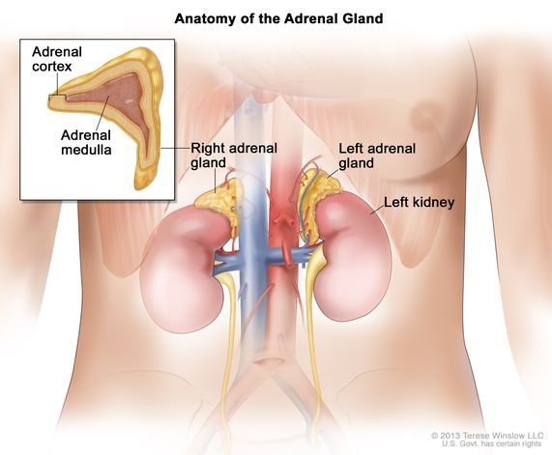

Slide 4
Anatomy of the Adrenal Glands
Structure:
Two regions: outer cortex & inner medulla.
Cortex makes up 80‑90% of gland mass & is split into three zones: zona glomerulosa, zona fasciculata & zona reticularis.
Medulla is the central portion, surrounded by cortex.

Slide 5
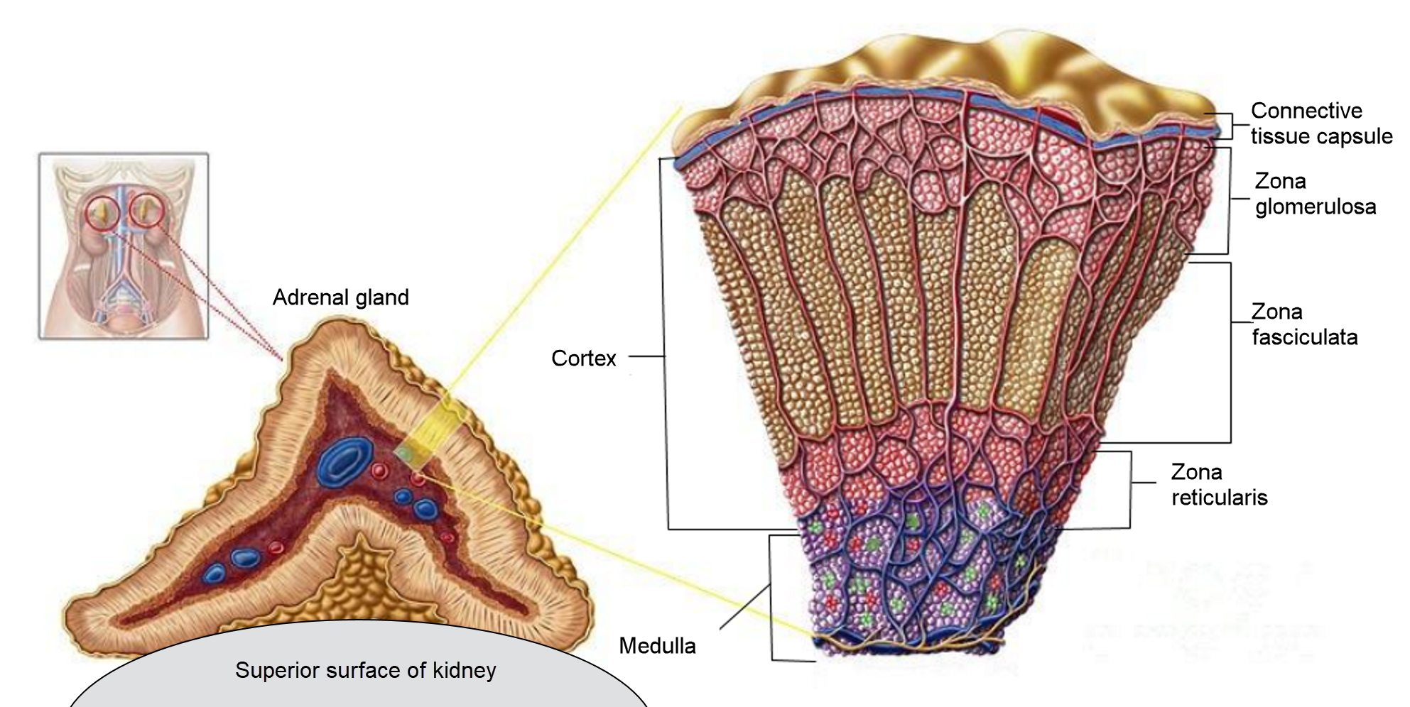

Slide 6
Adrenal Cortex
Zona Glomerulosa: outermost layer → produces mineralocorticoids (aldosterone) → regulates electrolyte (Na⁺/K⁺) balance & blood pressure.
Zona Fasciculata: middle layer → synthesizes glucocorticoids (cortisol) → controls metabolism, immune response & stress.
Zona Reticularis: innermost layer → produces androgens (DHEA & androstenedione) → precursors for sex hormones.

Slide 8
Adrenal Medulla
Composed of chromaffin cells
Secretes catecholamines: adrenaline (epinephrine) & noradrenaline (norepinephrine).
Triggers acute stress response: ↑ heart rate, blood pressure, respiratory rate & energy mobilization.

Slide 10
Blood Supply
Arterial supply from abdominal aorta branches: superior & middle adrenal arteries.
Venous drainage via adrenal veins → right side empties into inferior vena cava; left side into left renal vein.

Slide 11
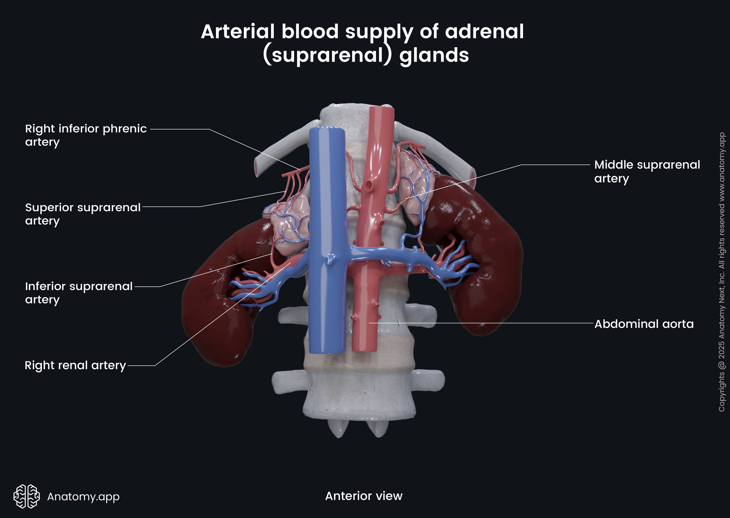

Slide 12
Innervation
Innervated by sympathetic nerve fibers of the autonomic nervous system.
Sympathetic stimulation triggers the release of catecholamines (epinephrine & norepinephrine) from the adrenal medulla, enhancing the body's response to stress and promoting the “fight or flight” reaction.

Slide 13
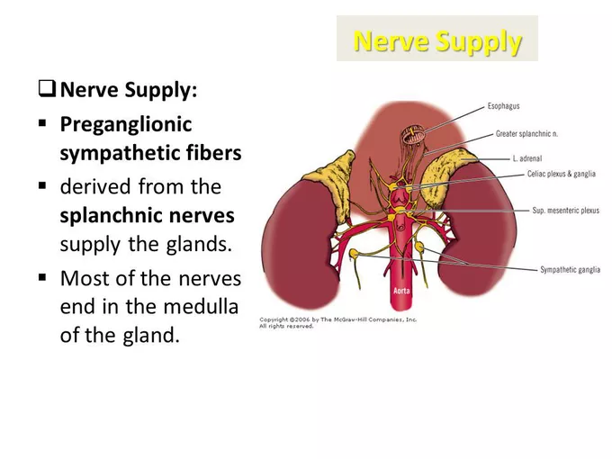

Slide 14
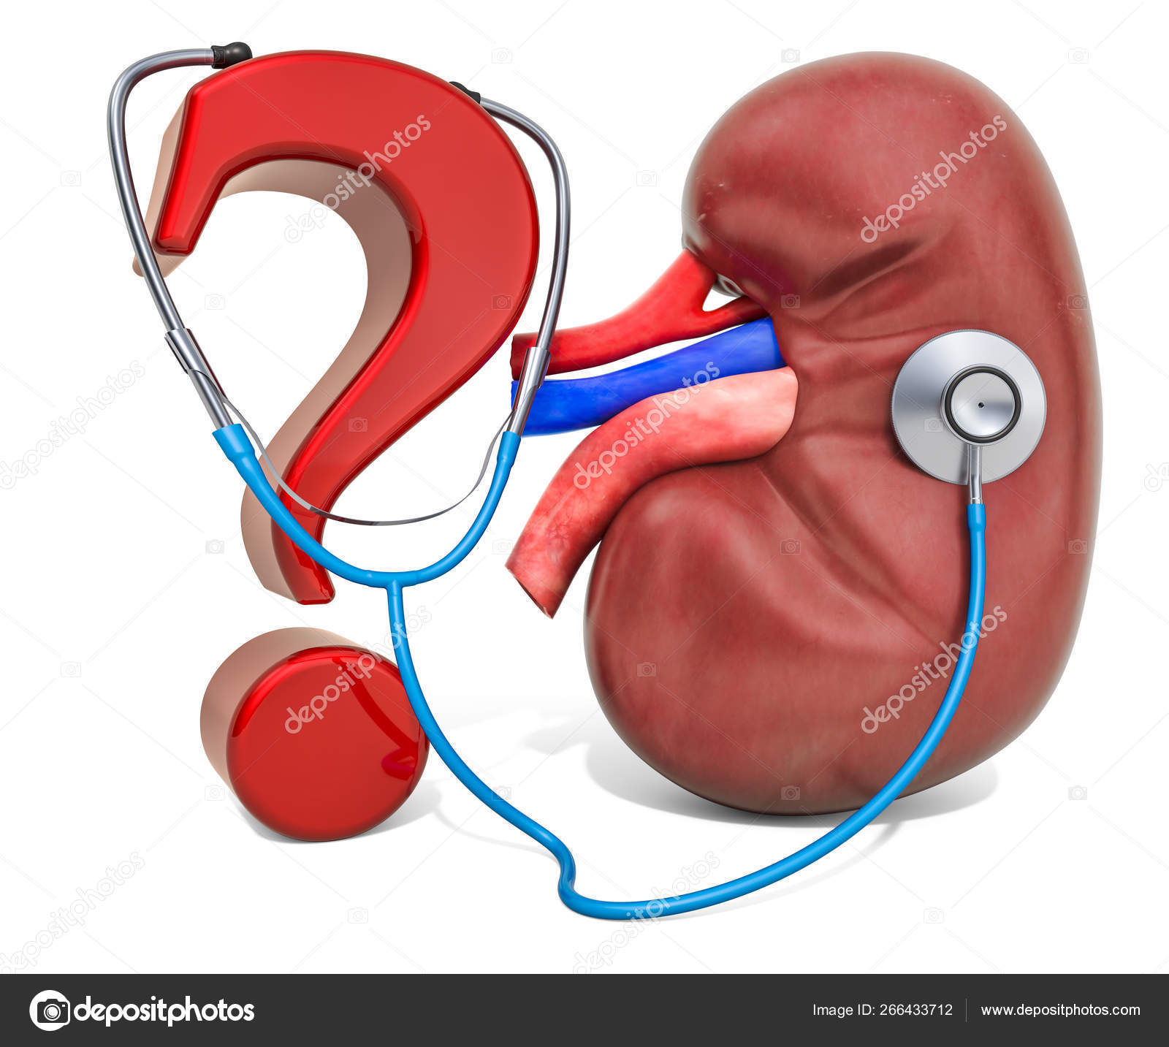

Slide 15


