Slide 1
Equipment Used in O.T
FSC OT
ADNAN RAMZAN

Slide 2
Electro-Medical Equipment Used in O.T.
Anesthesia Machine / Monitor
Surgical Microscope
Operating Lights
Blood Warmer
Video Monitors & Cameras

Slide 3
Desk / Computer
ECG Machine
Laser
Defibrillator
Pulse Oximeter

Slide 4
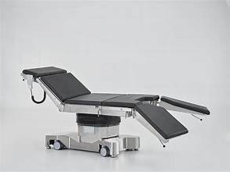

Slide 5
Operation Table
Used for both general & complex surgical procedures.
Keeps the patient stable during surgery.
Different tables for different specialties (e.g., orthopedic tables).
Adjustable height, tilt, and patient positioning.

Slide 6
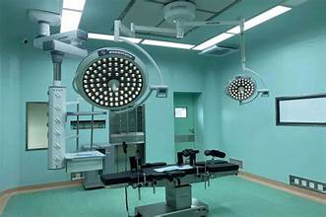

Slide 7
Operation Theatre Light
Essential for clear visibility during surgery.
LED and halogen lights commonly used.
Should provide shadowless illumination.
Helps surgeons visualize small structures clearly.
Types: Ceiling-mounted, Wall-mounted, Floor stand.

Slide 8
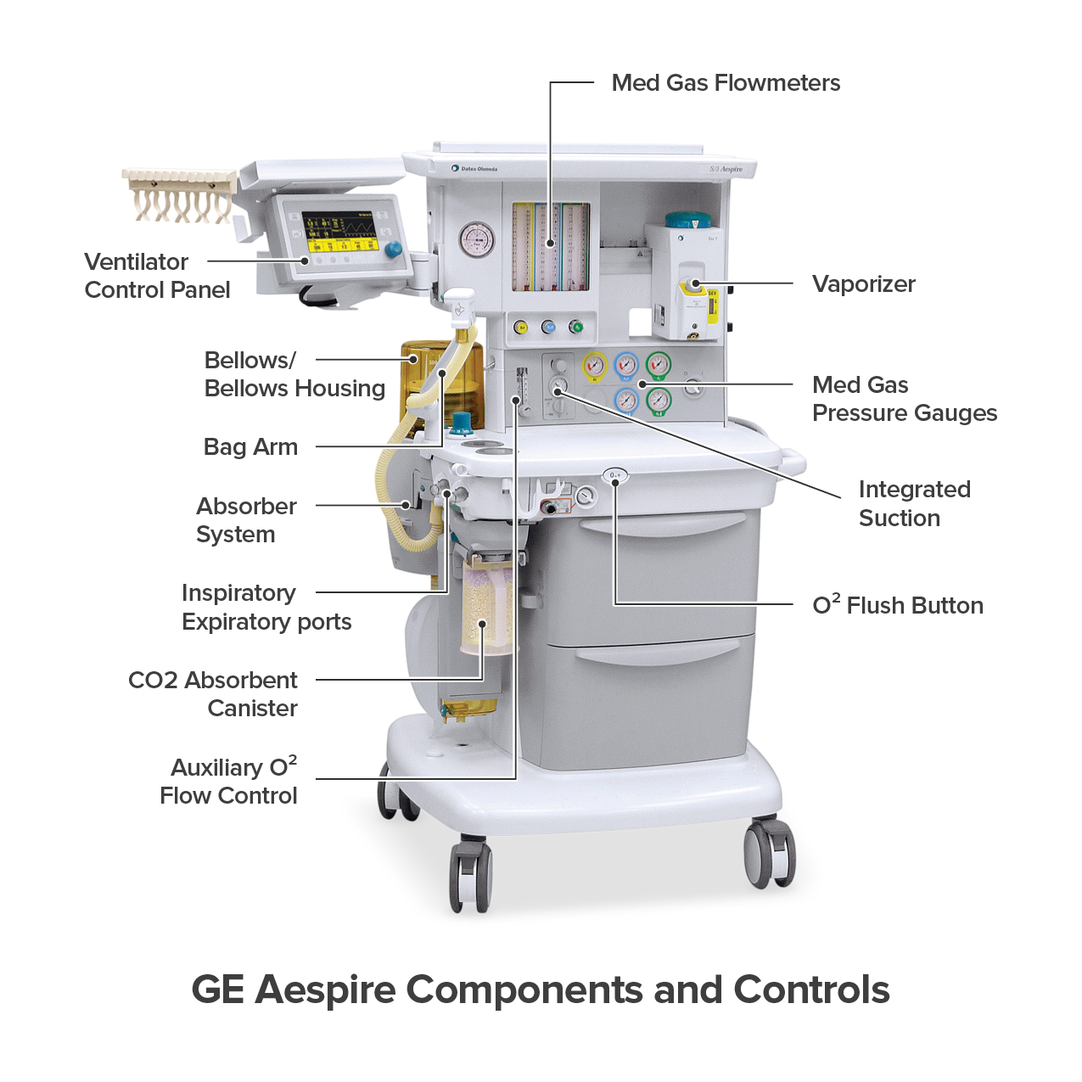

Slide 9
Anesthesia Machine
Delivers controlled anesthesia gases during surgery.
Maintains life-sustaining functions.
Also called anesthesia workstation.
Types: Air anesthesia machine, DC anesthesia machine, Closed anesthesia machine.

Slide 10
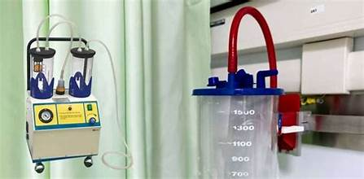

Slide 11
Suction Machine
Removes secretions from mouth, throat, or lungs.
Helps when the patient can't clear secretions themselves.
Used during surgeries to remove blood, , or fluids.

Slide 12
Sterilizer Machine
Used to sterilize surgical instruments using steam.
Essential to prevent infections.
Handles dressings, instruments, and other reusable items.

Slide 13
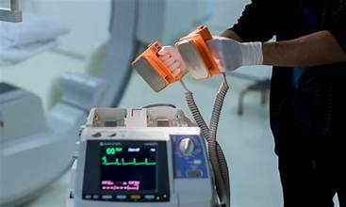

Slide 14
Defibrillators
Delivers an electric shock to restore heart rhythm.
Used in cardiac arrest emergencies.
Helps return heart to normal rhythm.
Often required multiple times during recovery.

Slide 15
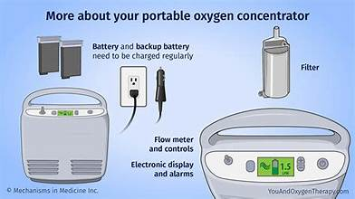

Slide 16
Oxygen Concentrators
Provide 90–95% pure oxygen.
Work by filtering and concentrating oxygen from room air.
Used for patients with breathing difficulty.
Safer and more convenient than oxygen cylinders.

Slide 17


