Slide 1
Grounding System & Surgical Lighting
ADNAN RAMZAN
FSC(OT)
Doctors Institute of Medical & Emerging Science

Slide 2
What is Grounding?
Provides a safe path for electrical current during faults.
Protects people and equipment from electric shocks.
Connects electrical systems to the earth.

Slide 3
Components of a Grounding System
Conductor – carries fault current safely.
Connector – joins conductor to electrode.
Electrode – rod or grid placed in soil.
Soil – provides resistance for current dissipation.

Slide 4
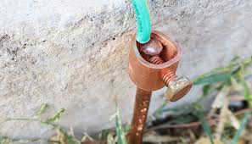
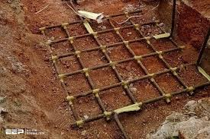

Slide 5
Grounding Rods
Made of copper, stainless steel, or conductive metals.
Increasing diameter reduces resistance only slightly.
Driving rod deeper significantly reduces resistance.
Doubling depth can reduce resistance up to 40%.

Slide 6
Grounding Grids
Multiple rods connected together.
Used in substations and large facilities.
Creates low-resistance paths and equal potential zones.
Improves grounding reliability.

Slide 7
Other Grounding Options
Grounding Plates – thin copper plates buried in soil.
Concrete-encased electrodes (Ufer ground).
Chemical rods – filled with electrolytic salts.
Used where soil resistivity is high.

Slide 8
Ground Resistance Concept
Electrode is surrounded by soil layers.
Outer layers add less resistance than inner layers.
Low soil resistivity = better grounding.
Resistance measured using ground tester.

Slide 9
Shadowless Surgical Lighting
Reduces shadows caused by tissue during surgery.
Modern LED lamps provide bright, uniform light.
Reflective surfaces help concentrate light.
Important for deep cavity surgeries.

Slide 10
Types of Surgical Lighting
Direct Lighting – shines straight onto surface.
Indirect Lighting – light reflected from ceiling.
Semi-Direct – mostly downward, some upward.
Semi-Indirect – mostly upward, some downward.
Diffused – soft, evenly spread light.

Slide 11
Why Good Lighting Matters in Surgery
Improves visibility of surgical area.
Reduces eye strain for surgeons.
Ensures accuracy and safety.
Prevents shadows and glare.

Slide 12
Extra Easy Points
Good grounding avoids fire and equipment damage.
Better soil = better grounding performance.
LED surgical lights consume less power.
Shadowless lights help surgeons work longer comfortably.

Slide 13


