Slide 1
Statistics
DPT
Awais Hamza

Slide 2
Subdivided (Component) Bar Chart
A Subdivided Bar Chart shows a single bar broken into parts, where each part represents a component of the total.
Useful for comparing composition (parts) across different categories.
Example:
A bar for each class, subdivided into boys and girls.

Slide 3
When to Use Subdivided Bar Charts
Use this chart when you want to show:
How a total is made up of different components
Comparison of parts within each category
Comparison of totals across categories

Slide 4
How to Draw a Subdivided Bar Chart
Select categories (e.g., Class A, B, C).
Convert values into heights/lengths.
Draw bars of equal width.
Divide each bar according to component values.
Shade each component differently.
Add legend and labels.

Slide 5
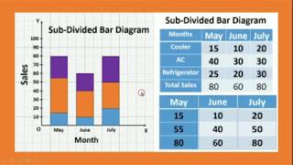

Slide 6
Practice Question
College | Urban | Rural
Alpha | 60 | 40
Beta | 30 | 50
Gamma | 70 | 30

Slide 7
Percentage Subdivided Rectangle
A Percentage Subdivided Rectangle represents parts of a whole using percentages inside a large rectangle.
The entire rectangle = 100%.
Each region inside represents a portion of the total, drawn proportionally.

Slide 8
When to Use Percentage Subdivided Rectangles
Use this chart when you want to:
Compare composition as percentages
Avoid absolute values and focus only on relative proportions
Present a single total broken into parts

Slide 9
How to Draw a Percentage Subdivided Rectangle
Convert all values into percentages.
Draw a large rectangle representing 100%.
Divide it into horizontal or vertical sections based on %.
Shade/color each percentage block.
Add labels + legend.

Slide 10
Practice Question
Sport | Students
Cricket | 50
Football | 30
Badminton | 20

Slide 11
Instructions for students
Convert the values into percentages.
Draw a 100% rectangle.
Subdivide into Cricket, Football, Badminton based on %.

Slide 12
