Slide 1
Statistics
DPT
Awais Hamza

Slide 2
Box Plot
A box plot is a visual summary of data that shows how values spread, where most values sit, and whether there are extreme outliers. Think of it like opening a parcel of numbers and seeing how they’re arranged inside.

Slide 3
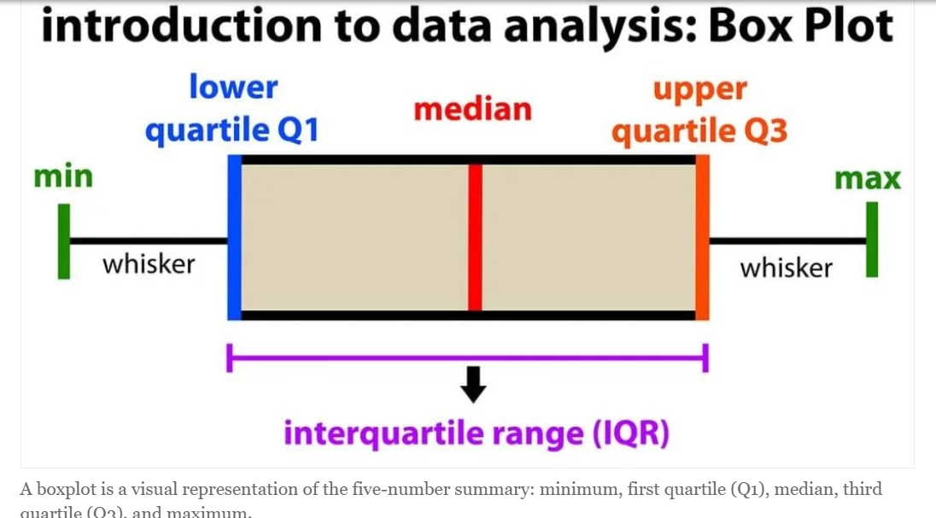

Slide 4
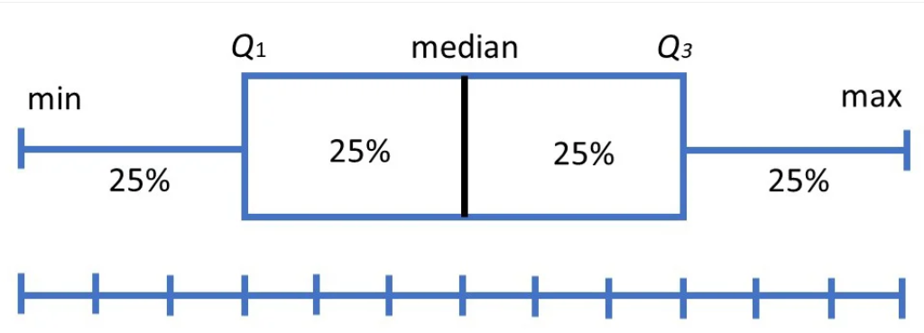
Box Plot

Slide 5
Parts of a Box Plot
1. Minimum
The smallest data point not considered an outlier.
Shown at the end of the lower whisker.
2. Q1 (Lower Quartile / 25th Percentile)
25% of the data lies below this value.
3. Median (Q2 / 50th Percentile)
Middle value.
Splits the data into two equal halves.

Slide 6
Parts of a Box Plot
4. Q3 (Upper Quartile / 75th Percentile)
75% of the data lies below this value.
5. Maximum
The largest data point not considered an outlier.
6. Interquartile Range (IQR)
IQR=Q3−Q1\text{IQR} = Q3 - Q1IQR=Q3−Q1 Measures the spread of the middle 50% of the data.
7. Outliers
Data points that sit unusually far from most others.

Slide 7
What a Box Plot Shows at a Glance
Spread (wide box = more variability).
Skewness (median closer to top/bottom of box).
Symmetry (median centered inside box).
Outliers (plotted as separate dots).
Comparison (multiple box plots compare groups easily).

Slide 8
Why Box Plots Are Useful
Perfect for comparing distributions.
Ignore noise and focus on structure.
Give insight even when you have large datasets.

Slide 9
Line Chart
A graphical way to show how a quantity changes over time.

Slide 10
What Is a Line Chart?
A line chart displays data points connected by straight lines.
It shows trends, patterns, and changes across intervals (usually time).
Perfect for showing increase, decrease, or fluctuation.

Slide 11
Key Parts of a Line Chart
X-axis: Time or categories
Y-axis: Values or measurements
Data points: Actual values
Line: Connects the points to show the trend
Labels / Title: Explain what the chart represents

Slide 12
Advantages and Limitations
Easy to interpret
Highlights trends clearly
Good for large datasets
Can compare more than one group (multiple lines)
Disadvantages: Not ideal for individual, unrelated categories

Slide 13
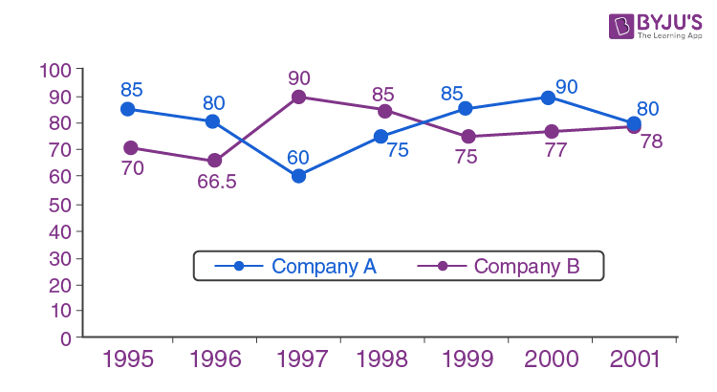

Slide 14
