Slide 1
Statistics
DPT
Awais Hamza

Slide 2
Pie Chart
In statistics, a pie chart is a circular graph used to visualize how different categories contribute to a single whole, displaying data as proportional slices of the circle. It is most effective for representing parts-to-whole relationships for a limited number of categories.

Slide 3
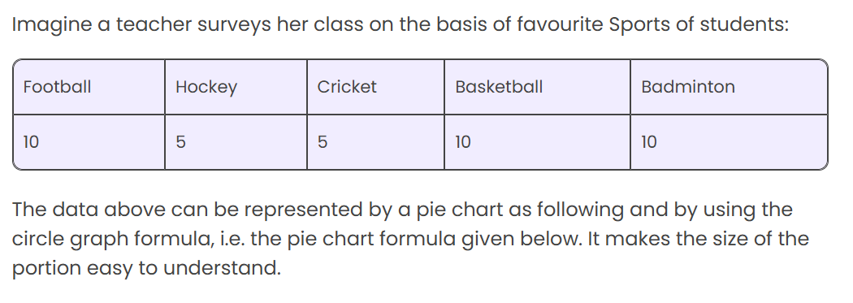
How to Create a Pie Chart?

Slide 4
Steps
Step 1: First, Enter the data into the table.
Step 2: Add all the values in the table to get the total.
I.e. Total students are 40 in this case.
Step 3: Next, divide each value by the total and multiply by 100 to get a per cen
Step 4: Next to know how many degrees for each “pie sector” we need, we will take a full circle of 360° and follow the calculations below:
The central angle of each component = (Value of each component/sum of values of all the components)✕360°

Slide 5
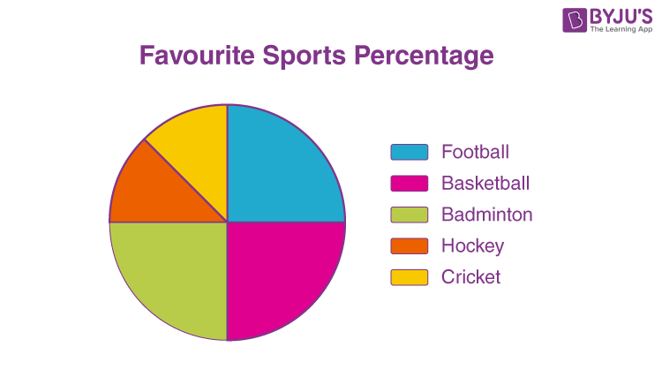
Step 5: Draw a circle

Slide 6
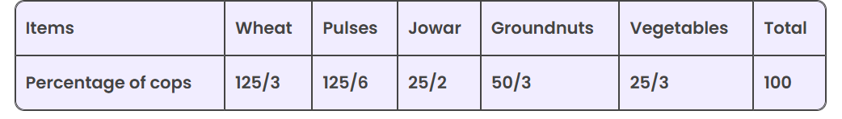
Question: The percentages of various cops cultivated in a village of particular distinct are given in the following table

Slide 7
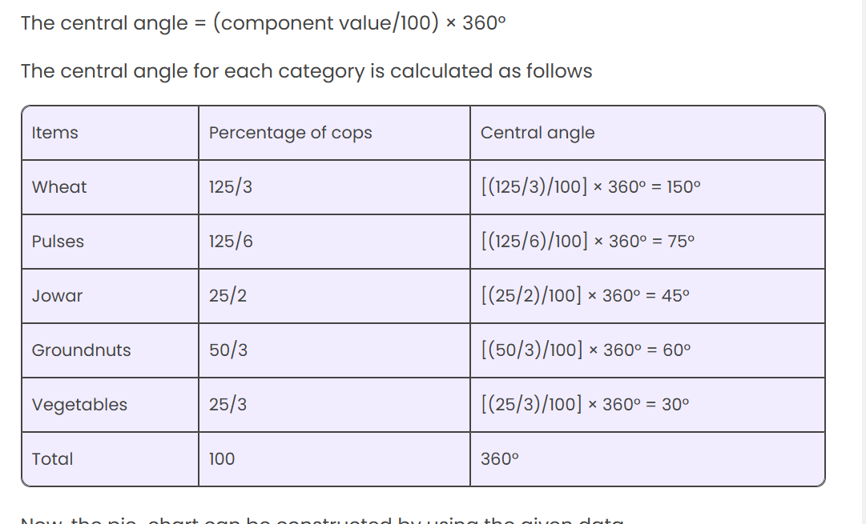
Step 1

Slide 8
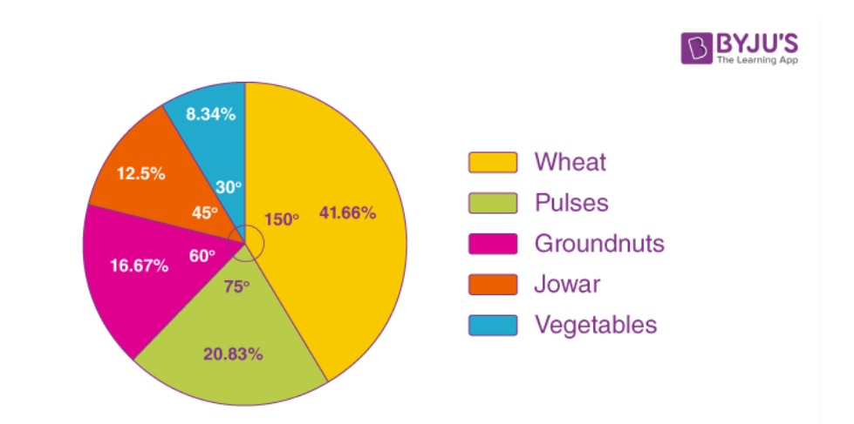

Slide 9
Multiple Bar Chart
Definition:
A multiple bar chart is a statistical chart that uses grouped bars to compare two or more related sets of data for multiple categories.
Purpose:
To compare variables side-by-side
To show patterns, similarities, or differences
Common in economics, education, industry, and research

Slide 10
When Do We Use a Multiple Bar Chart?
Use it when:
You need to compare more than one variable for the same category
Example: Marks of boys vs girls in different subjects
Example: Production of three factories over several years
Example: Monthly sales of different products
It helps to visualize comparisons clearly.

Slide 11
Structure of a Multiple Bar Chart
A multiple bar chart includes:
X-axis: Categories (e.g., years, subjects, products)
Y-axis: Values (frequency, marks, sales, etc.)
Groups of bars: Each group represents a category
Color/Pattern: Each variable has a unique color or pattern
Legend: Shows which color represents which variable

Slide 12
Steps to Draw a Multiple Bar Chart
Collect data for at least two variables.
Choose a suitable scale for the Y-axis.
Draw equal-width bars for each variable.
Place bars side by side within each category group.
Use different colors/patterns for different variables.
Add title, axis labels, and legend.

Slide 13
Example Data
Subject | Boys | Girls
Math | 75 | 85
English | 80 | 78
Science | 70 | 90

