Slide 1

Interjection & Preposition
English| FSC
Hafsa Rasheed

Slide 2
Definition
An Interjection isa word or phrase that expresses sudden emotion or feeling.
It is usually followed by an exclamation mark ❗
Definition: Words that show strong emotions such as surprise, joy, pain, anger, or sadness.
Examples:
Wow! That’s amazing.
Ouch! That hurt.
Hey! Stop that.
Oh no! lost my keys.

Slide 3
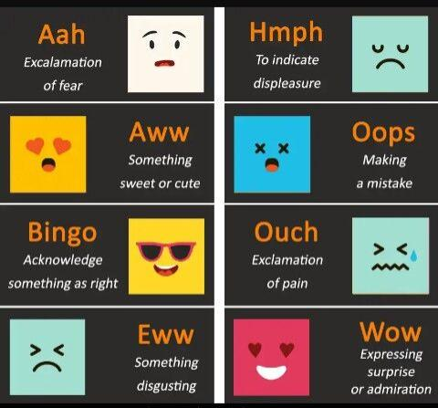
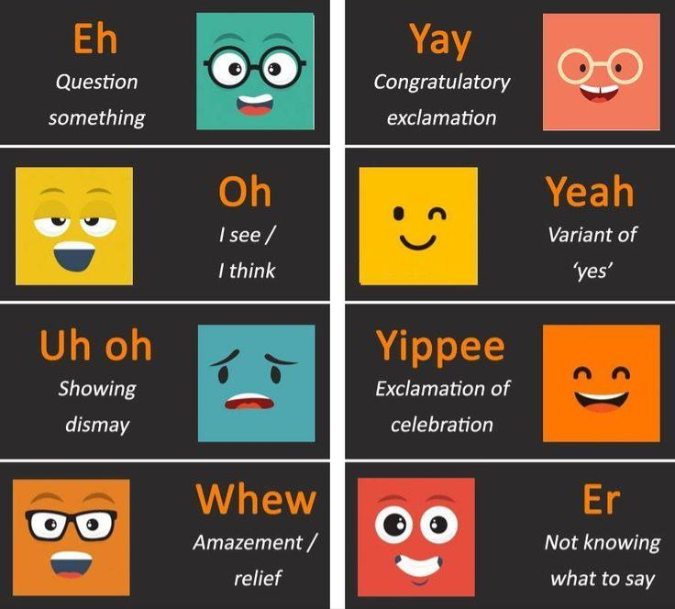
Think of interjections as emotional sound effects in English.

Slide 4
Interjection: Continued
Not grammatically connected to the rest of the sentence. They just express emotion and stand alone.
Example:
Wow! You look stunning.
Oops! Dropped my pen.

Slide 5
Preposition
A preposition connects a noun or pronoun to another word, showing relation of place, time, direction, cause, manner, etc.
Example:
The book is on the table.
She walked to the hospital.
He lives across the road.

Slide 6
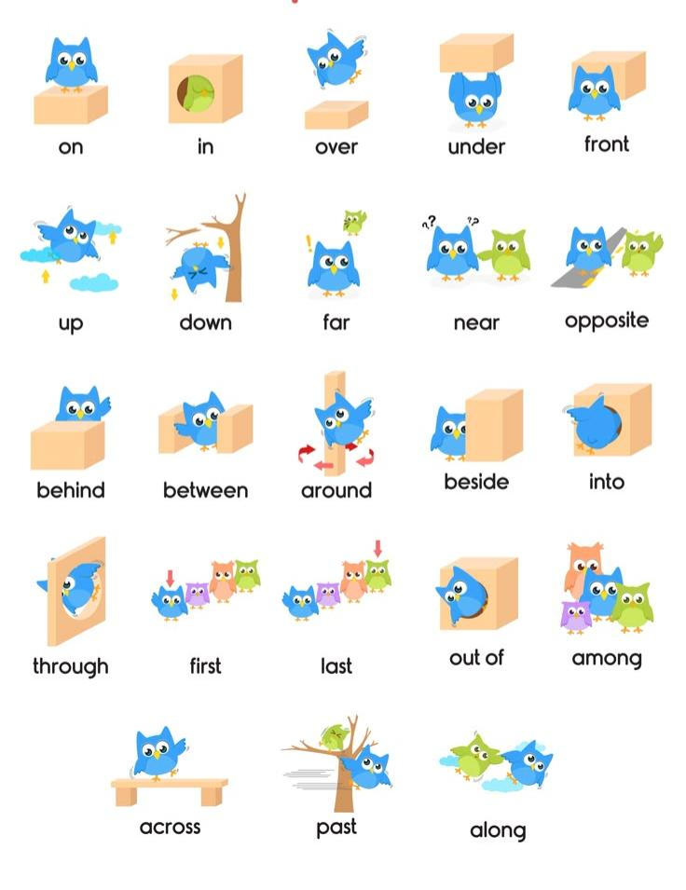

Slide 7
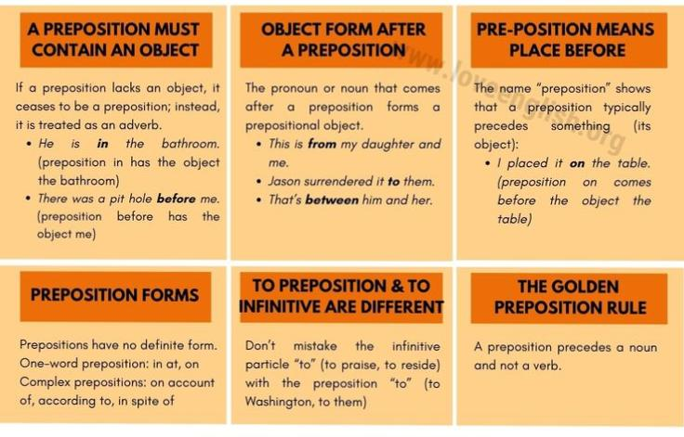

Slide 8
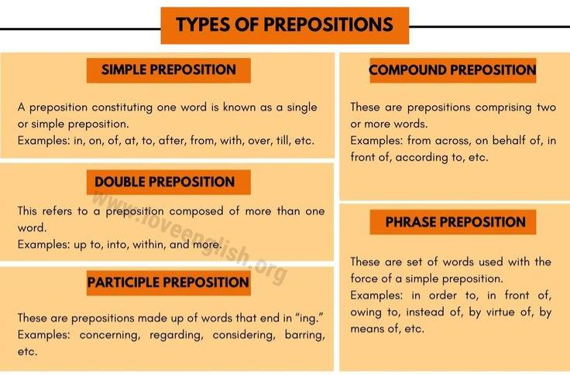

Slide 9
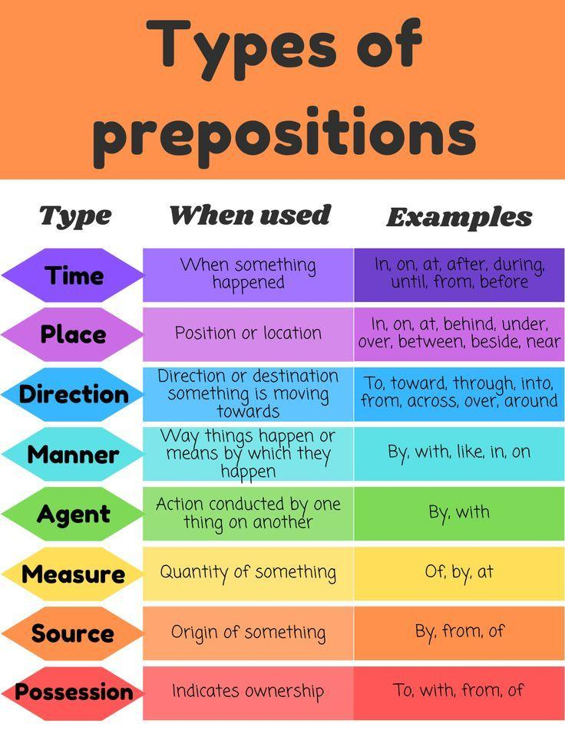

Slide 10
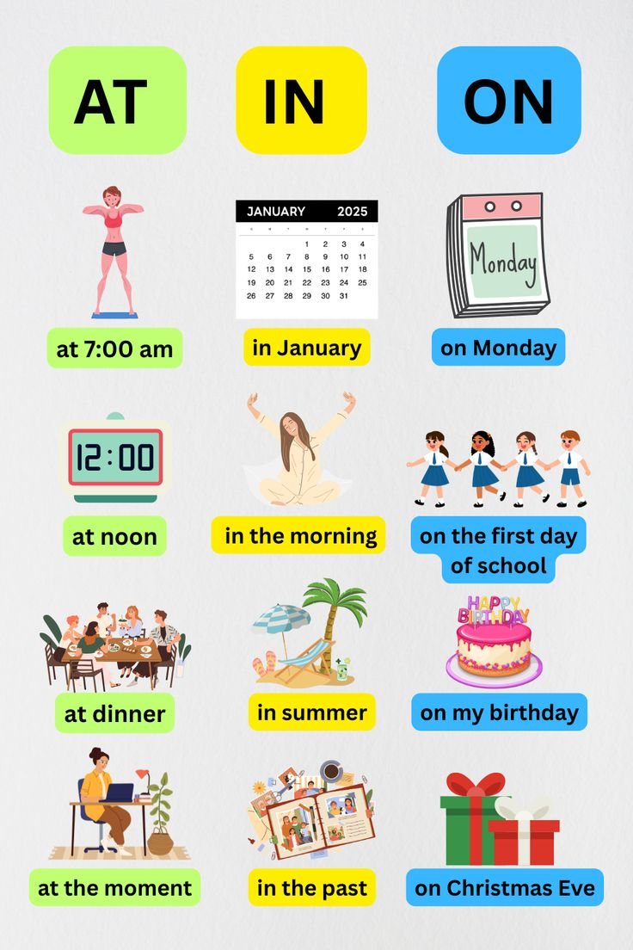

Slide 11
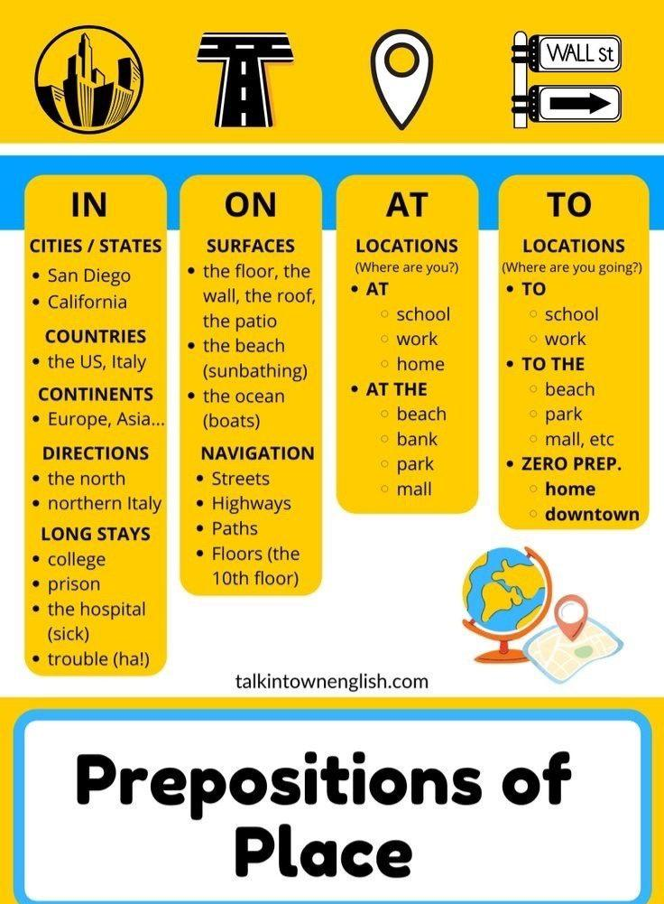

Slide 12
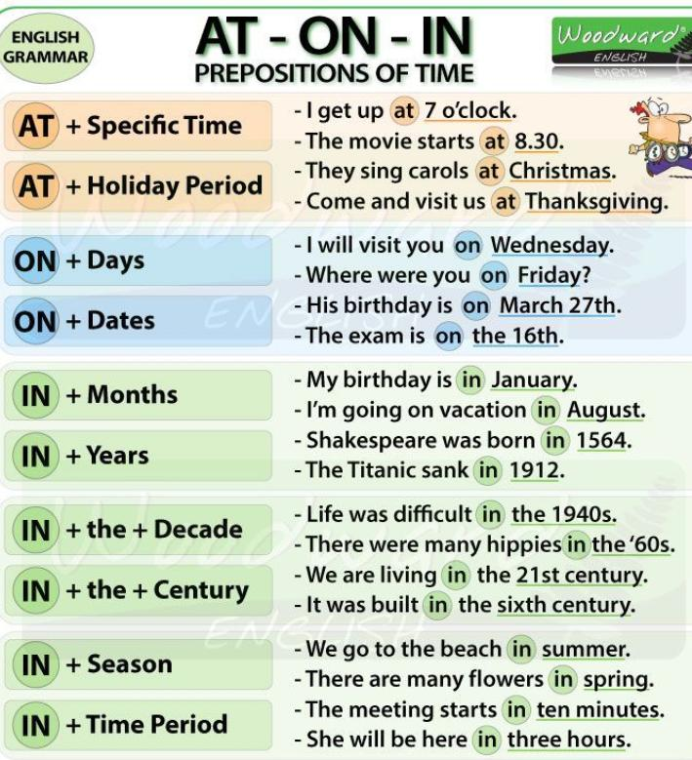

Slide 13
Common Errors with Preposition
Incorrect: She discussed about the problem.
Correct: She discussed the problem.
Incorrect: He married with a doctor.
Correct: He married a doctor.
Incorrect: I am waiting for you since morning.
Correct: I have been waiting for you since morning.

