Slide 1
Statistics
DPT
Awais Hamza

Slide 2
What is a Histogram?
A histogram is a graphical representation of continuous data.
Uses adjacent (touching) bars.
Each bar represents a class interval.
Height of bar = frequency of that class.
Used to understand shape of distribution (skewness, symmetry, spread).

Slide 3
When to Use a Histogram
When data is continuous.
When you want to show distribution clearly.
To compare spreads, peaks, or variation in data.
Best for large datasets.

Slide 4
Steps to Construct a Histogram
Make a frequency table (class intervals & frequency).
Draw x-axis → class intervals.
Draw y-axis → frequency.
Draw bars with no gaps.
Label axes & give title.

Slide 5
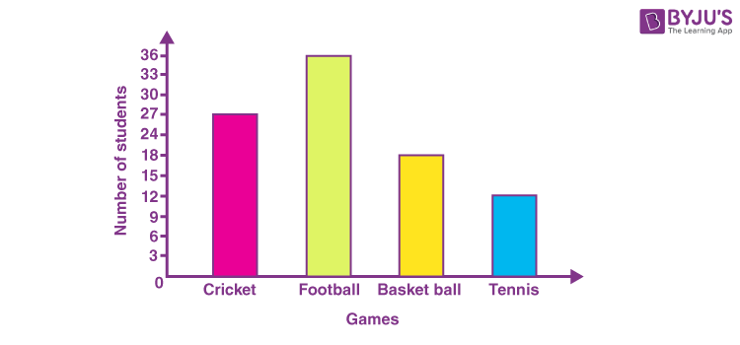
Histogram Example
Data: Marks of students
Class Intervals|Frequency
10–20 | 3
20–30 | 5
30–40 | 8
40–50 | 4
50–60 | 2

Slide 6
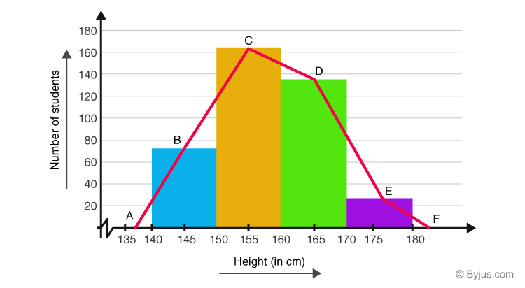
Steps to Draw Frequency Polygon
Make frequency table.
Calculate class midpoints = (lower limit + upper limit)/2.
Plot midpoints on x-axis with frequency on y-axis.
Join points with straight lines.
Extend to zero frequency at start and end for closure.

Slide 7
Frequency Polygon Example
Class Interval | Frequency | Midpoint
10–20 | 3 | 15
20–30 | 5 | 25
30–40 | 8 | 35
40–50 | 4 | 45
50–60 | 2 | 55

Slide 8
What is a Frequency Curve?
A smooth, free-hand curve drawn through the points of a frequency polygon.
Shows the overall shape of distribution more clearly.
Used for large datasets where smoothness is meaningful.

Slide 9
Properties of Frequency Curve
Smooth (no sharp points).
Starts and ends on the x-axis.
No bars—only curve.
Represents continuous distribution.
Helps visualize normal distribution, skewness.

Slide 10
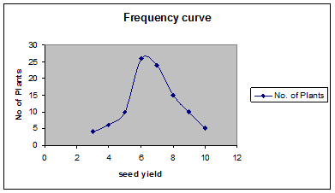
Frequency Curve Example
Plot midpoint vs frequency points.
Draw a smooth curve passing near them.
Should look like a mountain or skewed curve depending on data.

