Slide 1
Graphs
DPT
Awais Hamza

Slide 2
What is a Graph?
A graph is a visual representation of data used to communicate quantitative information clearly and effectively. It helps in summarizing large data sets and highlighting patterns, trends, and relationships.

Slide 3
Reasons for Drawing Graphs
Graphs are used in statistics for several important reasons:
Visual Clarity: They simplify complex numerical data and make it easier to understand at a glance.
Data Comparison: Graphs help compare different datasets or variables effectively.
Trend Identification: Patterns and trends over time become clear, especially in time series data.
Outlier Detection: Unusual or extreme values in the data set become apparent.
Effective Communication: Graphs help convey information quickly in reports, presentations, and publications.

Slide 4
Common Uses of Graphs
Graphs are widely used in various fields and contexts, including:
Scientific Research: To display experiment results and infer correlations.
Business Analytics: To track sales, profits, and market trends.
Education: To explain statistical concepts and performance data.
Public Health: To monitor disease occurrences or the impact of interventions.
Government & Policy-making: To show demographic, economic, or environmental statistics for decision-making.

Slide 5
Important Points for Drawing Graphs
To create a clear and effective graph, keep in mind the following:
Choose the Right Type of Graph: Select a graph that best suits the type of data (e.g., bar chart for categorical data, line graph for trends, pie chart for proportions).
Label Clearly: Axes, variables, units of measurement, and titles should be clearly labeled.
Use Appropriate Scale: Avoid misleading impressions with distorted scales.
Maintain Simplicity: Avoid unnecessary decoration or clutter; focus on clarity.

Slide 6
Important Points for Drawing Graphs
Ensure Accuracy: Data points must be accurately plotted; no values should be omitted or manipulated.
Highlight Key Insights: Use markers or annotations if needed to emphasize trends or significant points.
Use Consistent Colors/Patterns: This helps the audience interpret data consistently.

Slide 7
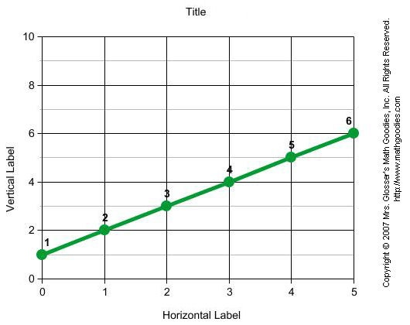

Slide 8
How to Make Graphs
1. Understand Your Data
Identify the type of data:
  Quantitative (numerical): Continuous or discrete (e.g., height, test scores)
  Qualitative (categorical): Nominal or ordinal (e.g., gender, grade level)
Determine the purpose of the graph: trend, comparison, distribution, proportion, etc.

Slide 9
Choose the Right Type of Graph
Data Type | Graph Type | Use Case
Categorical | Bar chart, Pie chart | Compare categories, show proportions
Quantitative | Line graph, Histogram, Dot plot | Show trends, frequency distribution
Relationship between variables | Scatter plot | Show correlation or patterns
Time series | Line graph | Show change over time

Slide 10
Prepare the Data
Organize data in tables or lists.
Calculate frequencies, percentages, or cumulative values if needed.
Identify ranges and intervals for axes.

Slide 11
Draw the Graph
Set up axes (for 2D graphs):
X-axis (horizontal): Independent variable or categories
Y-axis (vertical): Dependent variable or values
Mark scale properly:
Use even intervals.
Ensure origin is clear (0) unless a truncated axis is justified.

Slide 12
Draw the Graph
Plot the points or bars:
  For line graphs: plot points and connect with lines.
  For bar charts: draw bars of equal width with spacing.
  For pie charts: calculate percentages and draw sectors proportionally.
  For scatter plots: plot points to show relationships.
Add labels and titles:
  Graph title, axis labels, units of measurement.
  Legend if multiple data sets are shown.

Slide 13
Review and Refine
Check for accuracy in plotting.
Make sure data is clearly visible.
Avoid cluttered or misleading scales.
Highlight key trends or findings if necessary.

Slide 14
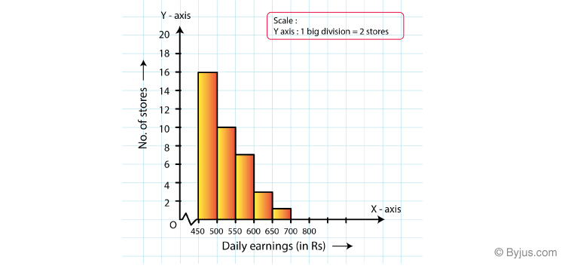

Slide 15
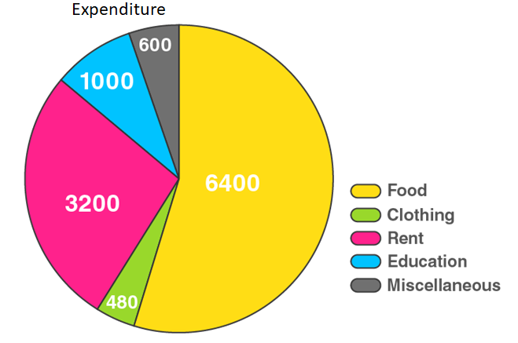

Slide 16
