Slide 1

BASIC MEDICAL SCIENCE
FSC MEDICAL TECHNOLOGIES I
DR DANISH

Slide 2
THE SPECIAL SENSES
Five special types of senses:
i. Vision
ii. Hearing
iii. Taste
iv. Smell
v. Touch

Slide 3
Eye (Organ of Vision)
Eyes are organs of the visual system.
Provide living organisms with vision
the ability to receive & process visual detail + photo response functions independent of vision.
Detect light & convert it into electro‑chemical impulses in neurons.

Slide 4
Structure of the Eye Ball
Eye ball ≈ 2.5 cm in diameter; compared to an old fashioned box camera.
Three circular layers form the eye wall.
Light passes through the cornea → lens → image focuses on the retina (acts like film).
Retina contains ~100 million photoreceptor cells (rods & cones) that convert light waves into electrochemical impulses sent to the brain.

Slide 5
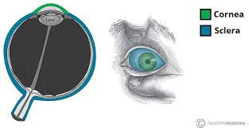

Slide 6
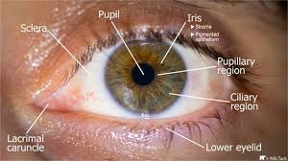

Slide 7
Anatomical parts shown in diagrams
External parts: Eyelid, Conjunctiva, Sclera.
Internal structures: Cornea, Aqueous humour, Lens, Ciliary body, Suspensory ligament, Choroid, Retina, Macula, Fovea, Optic Nerve.

Slide 8
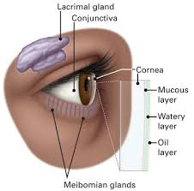

Slide 9
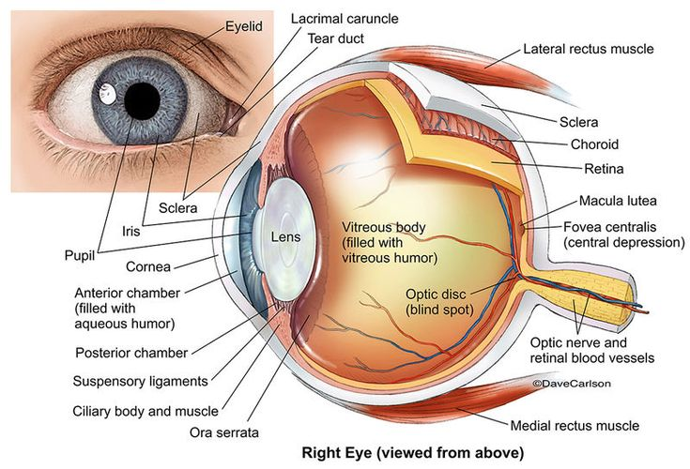

Slide 10
Anatomy of the Eyeball
Three circular layers of the eye ball:
1. Fibrous / Supporting layer: Sclera,Cornea
2. Avascular / Pigmented layer: Choroid,Ciliary body,Iris
3. Nervous / Retinal layer: Retina

Slide 11


Slide 12
Contents of Eyeball
Provide refracting media for the eye:
i. Aqueous humour
ii. Lens
iii. Vitreous body

Slide 13
Lens
Description: transparent, biconvex, elastic structure.
Location: lies between the iris and vitreous body.

Slide 14


Slide 15
Parts of Lens
i.Superficial part → Cortex
ii. Deep part → Nucleus

Slide 16
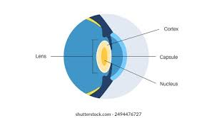

Slide 17
Functions of Lens
Refracts light and focuses it on the retina.

Slide 18
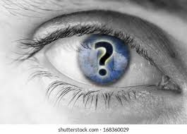

Slide 19
