Slide 1

GENERAL ANATOMY
DPT
1ST SEMESTER
DR DANISH

Slide 2
Rule of Ossification
Overview:
Long bones follow a predictable ossification pattern
Each end of a bone has its own secondary ossification center
The center that appears first typically fuses with the shaft later

Slide 3
Growing End Hypothesis
One end of a long bone grows for a longer duration than the other
This end is called the growing end
Growing end = secondary center that appears first
Growing end = last to fuse with diaphysis

Slide 4
How to Identify a Growing End
Compare timing of secondary ossification center appearance
The earlier the appearance → the longer it grows
The later it fuses → the more it contributes to bone length
Clinical relevance in pediatric fractures and growth disorders

Slide 5
Nutrient Foramen Rule
Nutrient foramina carry blood vessels into bone
Direction of the nutrient canal depends on bone growth
Nutrient canal always points away from the growing end

Slide 6
Growing Ends in Upper Limb Bones
Humerus: growing end = upper end
Radius: growing end = lower (distal) end
Ulna: growing end = upper end (proximal)

Slide 7
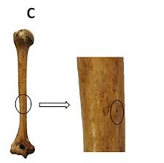
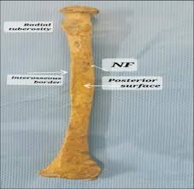

Slide 8
Growing Ends in Lower Limb Bones
Femur: growing end = lower (distal) end
Tibia: growing end = upper (proximal) end

Slide 9
Direction of Nutrient Foramina
Humerus → downward
Radius & Ulna → upward
Femur → upward
Tibia → downward

Slide 10
MNEMONICS
“From the knee I flee, toward the elbow I go.”
Meaning:
Nutrient canals move away from the knee joints
Nutrient canals move toward the elbow joints

Slide 11
Exception: The Fibula
Fibula breaks the standard rule
Secondary center appears first at distal end (unusual)
Proximal center appears later

Slide 12
Fusion Pattern in Fibula
Distal epiphysis fuses early (15 yrs girls, 17 yrs boys)
Proximal epiphysis fuses later (17–19 yrs)
Therefore: nutrient foramen of fibula runs upwards, unlike tibia

Slide 13
Types of Epiphyses
1. Pressure epiphyses
2. Traction epiphyses
3. Atavistic epiphyses
4. Aberrant epiphyses

Slide 14
Pressure Epiphyses
Pressure Epiphyses
Located at ends of long bones forming joints
Bear weight or transmit forces during movement
Always participate in joint formation
Examples: head of femur, head of humerus

Slide 15
Traction Epiphyses
Non-articular ends
Do not take part in joint formation
Serve as major tendon and ligament attachment sites
Ossify later than pressure epiphyses
Examples: greater/lesser trochanters, greater/lesser tubercles

Slide 16
Atavistic Epiphyses
Represent bones that were separate in lower animals during evolution
In humans, they fuse with another bone
Evolutionary remnants
Example: coracoid process (was once a separate bone — coracoid)

Slide 17
Aberrant Epiphyses
Epiphyses that deviate from the typical pattern
Not consistently present in all individuals
Appear at unusual locations
May occur in metacarpals and phalanges

Slide 18
Examples of Aberrant Epiphyses
May be found at:
• Head of the first metacarpal
• Bases of some other metacarpals

Slide 19
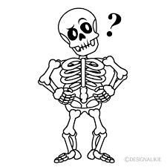

Slide 20
