Slide 1
Physiology
BS Hons
Awais Hamza

Slide 2
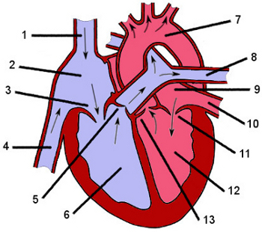

Slide 3
Right-Sided Structures
Right Atrium: receives deoxygenated blood from body
Tricuspid Valve: RA → RV
Right Ventricle: pumps blood to lungs

Slide 4
Left-Sided Structures
Left Atrium: receives oxygenated blood from lungs
Mitral Valve: LA → LV
Left Ventricle: pumps blood to body (systemic circulation)

Slide 5
Heart Valves
AV Valves
Tricuspid (right)
Mitral (left)
Semilunar Valves
Pulmonary valve (RV → lungs)
Aortic valve (LV → aorta)

Slide 6
Major Vessels
Entering the Heart:
Superior Vena Cava (SVC)
Inferior Vena Cava (IVC)
Pulmonary Veins (4)
Leaving the Heart:
Pulmonary Artery
Aorta

Slide 7
Septa (Heart Walls)
Interatrial septum (between atria)
Interventricular septum (between ventricles)

Slide 8
Conduction System
SA Node (pacemaker)
AV Node
Bundle of His
Right & Left Bundle Branches
Purkinje Fibers

