Slide 1

Extra Heuristics
Social Psychology
Hafsa Rasheed

Slide 2
What Are Extra Heuristics?
Heuristics = Mental shortcuts
Used when:
Time is limited
Information is incomplete
Emotional load is high
Cognitive resources are low
These extra heuristi cs extend beyond Kahneman & Tversky’s original three.

Slide 3

Affect Heuristic
Judging risk, safety, and decisions based on emotions, not logic.
Pioneers:
Paul Slovic (American, University of Oregon), 2002. formally articulated affect heuristic
Kahneman & Tversky connected emotions and judgment (1970s-1990s)

Slide 4
Slovic Risk Perception Studies (1980-2002)
Researcher: Paul Silovic
Method: Participants rated how risky or beneficial various technologies were.
Key Finding:
safer.
If something created fear (e.g., nuclear power), people judged it as highly risky regardless of statistics.

Slide 5
Affect Heuristics: Examples
Global
Avoiding flights after watching plane crash news
Attractive packaging product feels “premium”
Politicians with warm smiles seem trustworthy
Pakistan
Crime-heavy TV news people believe
Pakistan is unsafe everywhere”
Parents choosing schools because emotional ads show “bright futures”
Fear-based political speeches sway public opinion

Slide 6
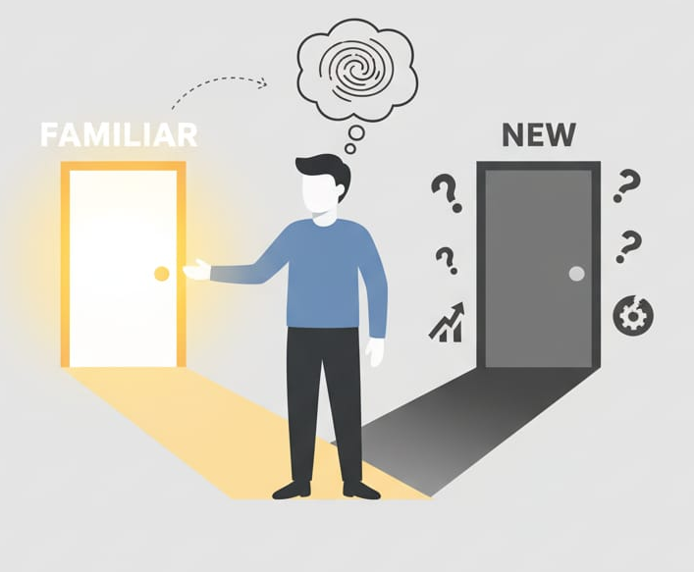
Recognition Heuristics
When choosing between two options, people prefer the one they recognize.
Pioneers:
Gerd Gigerenzer (German, Max Planck Institute)
Daniel Goldstein (American)
Proposed formally in 1996-1999

Slide 7
German Cities Study (Goldstein & Gigerenzer, 1999)
Method:
German students were asked: “Which city is larger: San Diego or San Antonio?” Americans knew both accuracy dropped. Germans recognized only San Diego accuracy increased.
Finding:
Recognition alone led to better decisions.

Slide 8
Recognition Heuristics: Examples
Global
Choosing Apple over new tech brands
Famous political names get more votes Students prefer famous universities
Pakistan
Coke/Pepsi > unknown brands
“HEC recognized” universities chosen immediately
People vote for parties with famous surnames

Slide 9

Fast and Frugal Heuristics
Using simple rules with only 1-2 cues to make quick, effective decisions.
Pioneer:
Gerd Gigerenzer (Germany), 1999
book “Simple Heuristics That Make Us Smart”

Slide 10
Heart Failure Triage Study (1999)
Researchers:
Gigerenzer & Todd
Method:
Doctors used a 3-step “fast rule” to decide which patients need emergency care.
Finding:
Simple rule outperformed complex statistical models.

Slide 11
Global
Online shopping: “If reviews high + price low buy”
Judges using only criminal record for bail decisions
Pakistan
Government doctors diagnosing using 1-2 symptoms
Students choosing academies based on “fees reputation”

Slide 12
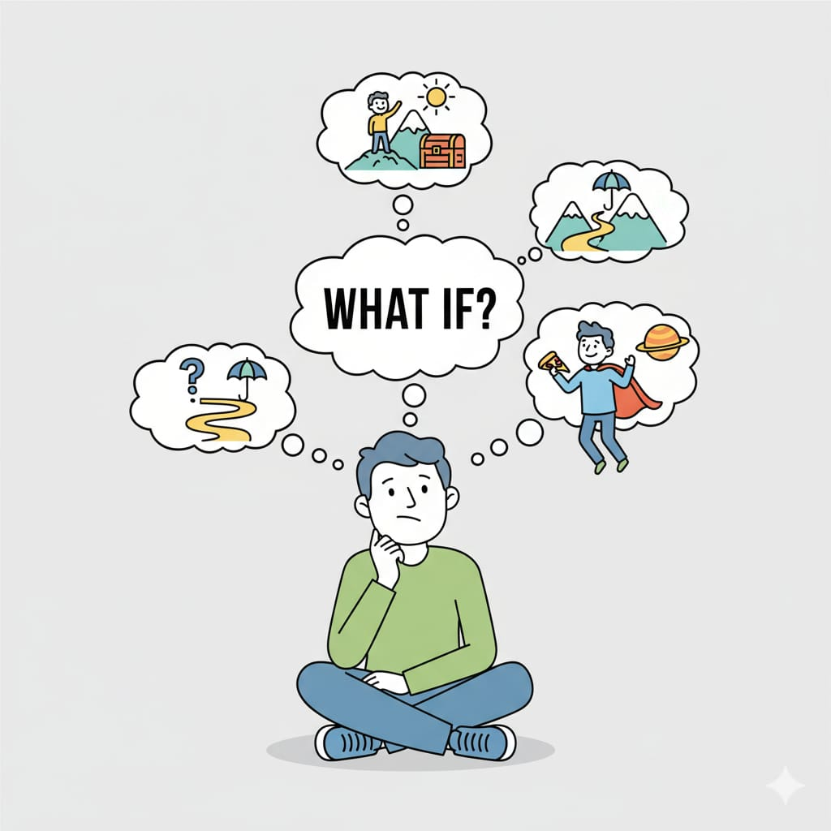
Simulation Heuristics
Judging likelihood based on how easily you can imagine an event.
Pioneers:
Daniel Kahneman & Amos Tversky (lsraeli-American psychologists), 1982
Introduced simulation and counterfactual thinking (“What if..”).

Slide 13
Near-Miss Regret Study (Kahneman & Tversky, 1982)
Method:
Participants shown two people missing a flight:
One by 2 hours
One by 2 minutes
Finding:
People believed the 2-minute person felt more upset easier to imagine alternate outcome.

Slide 14
Global
“If only studied more..” regret
Imagining accidents increases perceived risk nearly won!” feels meaningful
Pakistan
Missing CSS exam by 5 minutes = more emotional impact

Slide 15

Status Quo Heuristics
People prefer the current state and avoid change.
Pioneers:
William Samuelson & Richard Zeckhauser (American economists), 1988
Related to loss aversion (Kahneman & Tversky).

Slide 16
Insurance Choice Study (Samuelson & Zeckhauser, 1988)
Method:
Participants given options:
New insurance
Old insurance
Finding: Majority kept the old one even if new was cheaper & better.

Slide 17
Global
Keeping the same bank for years
Not upgrading phones
Staying in old policies
Pakistan
Keeping same SIM (Jazz/Telenor) for 10-15 years
Using same tutor from Matric to Intermediate
Buying from the same stall for years
Avoiding online banking due to fear of change

Slide 18


