Slide 1
Gravity
Fsc
AWAIS HAMZA

Slide 2
Gravity
Definition: is the force of attraction between two masses. On Earth, it pulls objects toward the center of the planet.
Key Concept:
All objects with mass experience gravity.
The acceleration due to gravity on Earth is approximately: g=9.8 m/s2

Slide 3
Gravity
Formula:
F=m×g
Where:
F= Force due to gravity (weight)
m = Mass of the object
g = Acceleration due to gravity

Slide 4
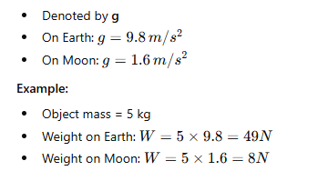
Acceleration Due to Gravity

Slide 5
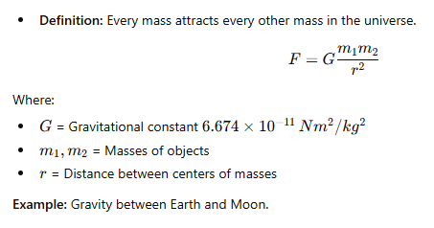
Universal Law of Gravitation

Slide 6
Weightlessness
Occurs when no net gravitational force acts on an object (free fall or orbit).
Astronauts in space feel weightless even though gravity exists.
Example: Space shuttle orbiting Earth.

Slide 7
Center of Gravity & Gravity Effects
Center of Gravity: Point where weight appears to act.
Stability depends on the position of center of gravity:
  Lower CG → more stable
  Higher CG → less stable
Example:
Upright human → CG near navel
Rod → CG at midpoint

Slide 8
Effects of Gravity in Daily Life
Objects fall when dropped.
Keeps planets in orbit around the Sun.
Tides caused by Moon’s gravitational pull.
Determines weight on different planets.

Slide 9
Example:
Mass of object = 10 kg
Gravity g=9.8 m/s2
Key Point:
Gravity is a force, while weight is the measurement of that force on Earth.

Slide 10
Speed and Velocity
Speed is how fast something moves.
Velocity is speed with a direction.
Saying Ariel the Dog runs at 9 km/h (kilometers per hour) is a speed.
But saying he runs 9 km/h Westwards is a velocity.

Slide 11
Speed vs Velocity
 | Speed | Velocity
Has: | magnitude | magnitude and direction
Example: | 60 km/h | 60 km/h North
Example: | 5 m/s | 5 m/s upwards

Slide 12
Speed
Speed is measured as distance moved over time.
Speed = Distance/Time
Example: A car travels 50 km in one hour.
Its average speed is 50 km per hour (50 km/h)
Speed = Distance/Time = 50 km/1 hour

Slide 13
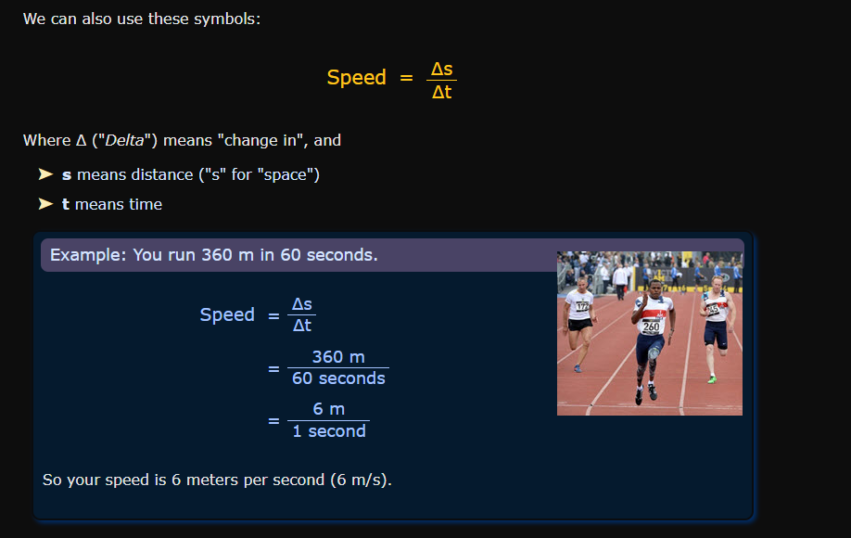
Speed

Slide 14
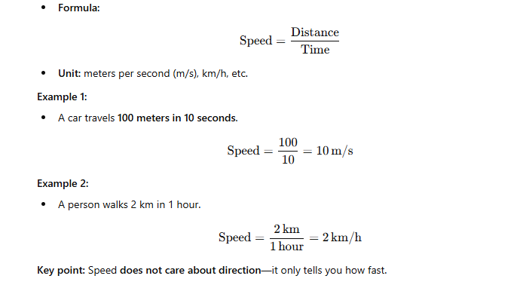
Speed

Slide 15
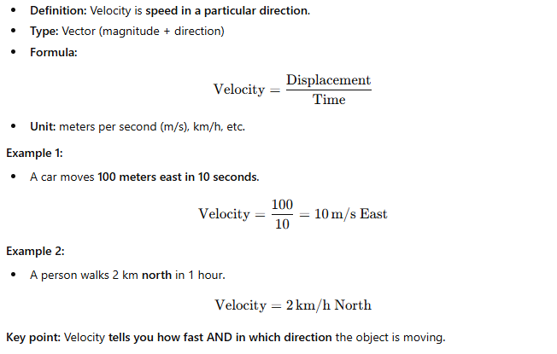
Velocity

Slide 16
Simple Comparison Table
Feature | Speed | Velocity
Definition | How fast an object moves | How fast and in what direction
Type | Scalar | Vector
Formula | Distance / Time | Displacement / Time
Example | 10 m/s | 10 m/s East
Direction | Not needed | Required

Slide 17
Acceleration
Definition:
Acceleration is the rate at which the velocity of an object changes.
If an object speeds up, slows down, or changes direction, it is accelerating.
Type: Vector (has magnitude and direction)

Slide 18
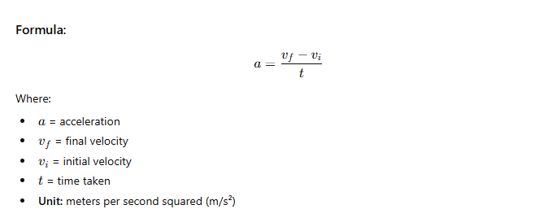
Acceleration

Slide 19
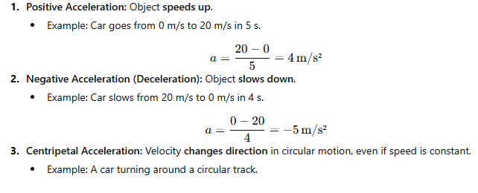
Types of Acceleration

Slide 20
Acceleration

