Slide 1

BASIC MEDICAL SCIENCE
FSC MEDICAL TECHNOLOGIES I
DR DANISH

Slide 2
Synovial Joints
Most common type of joint in the pelvic region.
Provide the greatest range of movement.
Characterized by a synovial cavity filled with synovial fluid.
Classified into six types based on structural features and movement capabilities.

Slide 3
Types of Synovial Joints
Hinge Joint:
Movement in one plane (flexion and extension).
Examples: elbow and knee joints.

Slide 4
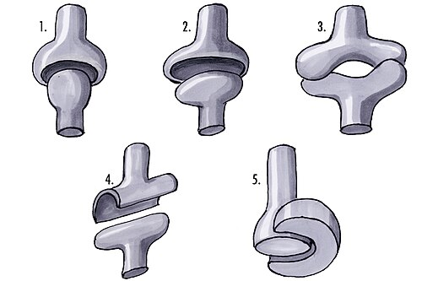

Slide 5
Continued
Pivot Joint:
Allows rotation around a central axis.
Seen in the proximal radioulnar joint.

Slide 6
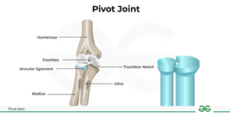

Slide 7
Continued
- Ball-and-Socket Joint:
Movement in multiple directions.
Examples: hip and shoulder joints.

Slide 8
Continued
- Condyloid Joint:
Found in the metacarpophalangeal joints.
Movement in two planes (biaxial movement).

Slide 9
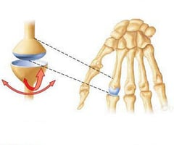

Slide 10
Continued
Saddle Joint:
The carpometacarpal joint of the thumb is an example.
Allows a greater range of motion than a condyloid joint.

Slide 11
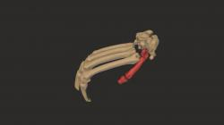

Slide 12
Continued
Gliding Joint:
These joints allow sliding or gliding movements between bones.
Examples include the intercarpal and intertarsal joints.

Slide 13
Components of synovial joints
Articular Cartilage:
Hyaline cartilage covering the ends of bones, providing a smooth, frictionless surface for movement

Slide 14
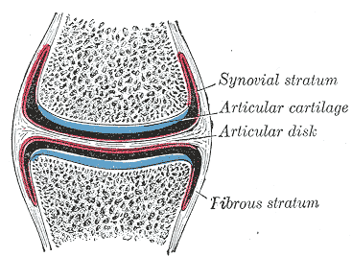

Slide 15
Continued
Joint Capsule:
A fibrous capsule surrounding the joint, consisting of an outer layer (fibrous membrane) and an inner layer (synovial membrane).

Slide 16
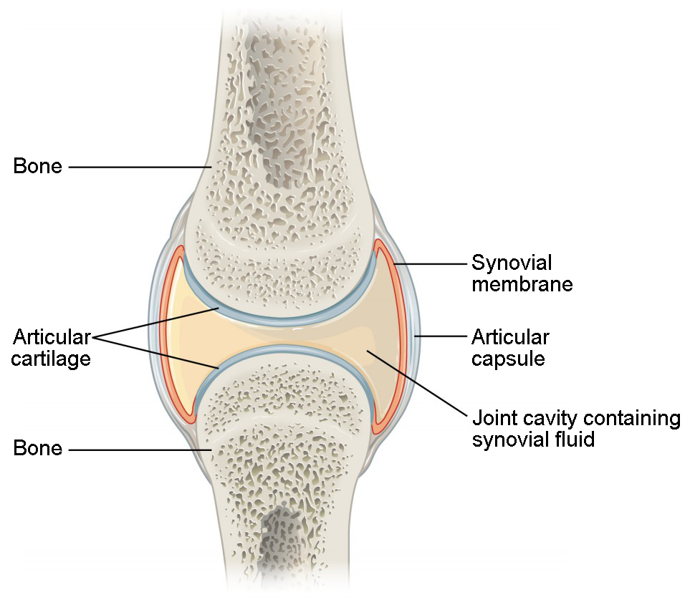

Slide 17
Continued
Synovial Fluid:
A lubricating fluid within the synovial cavity, reducing friction and nourishing the articular cartilage.

Slide 18
Continued
- Ligaments: Tough bands of fibrous connective tissue that connect bone to bone, providing stability and reinforcement.

Slide 19
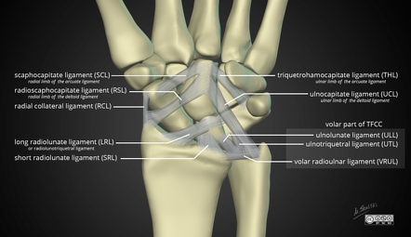

Slide 20
Continued
- Bursae:
Small fluid-filled sacs located near joints, reducing friction between tendons, ligaments, and bones.

Slide 21
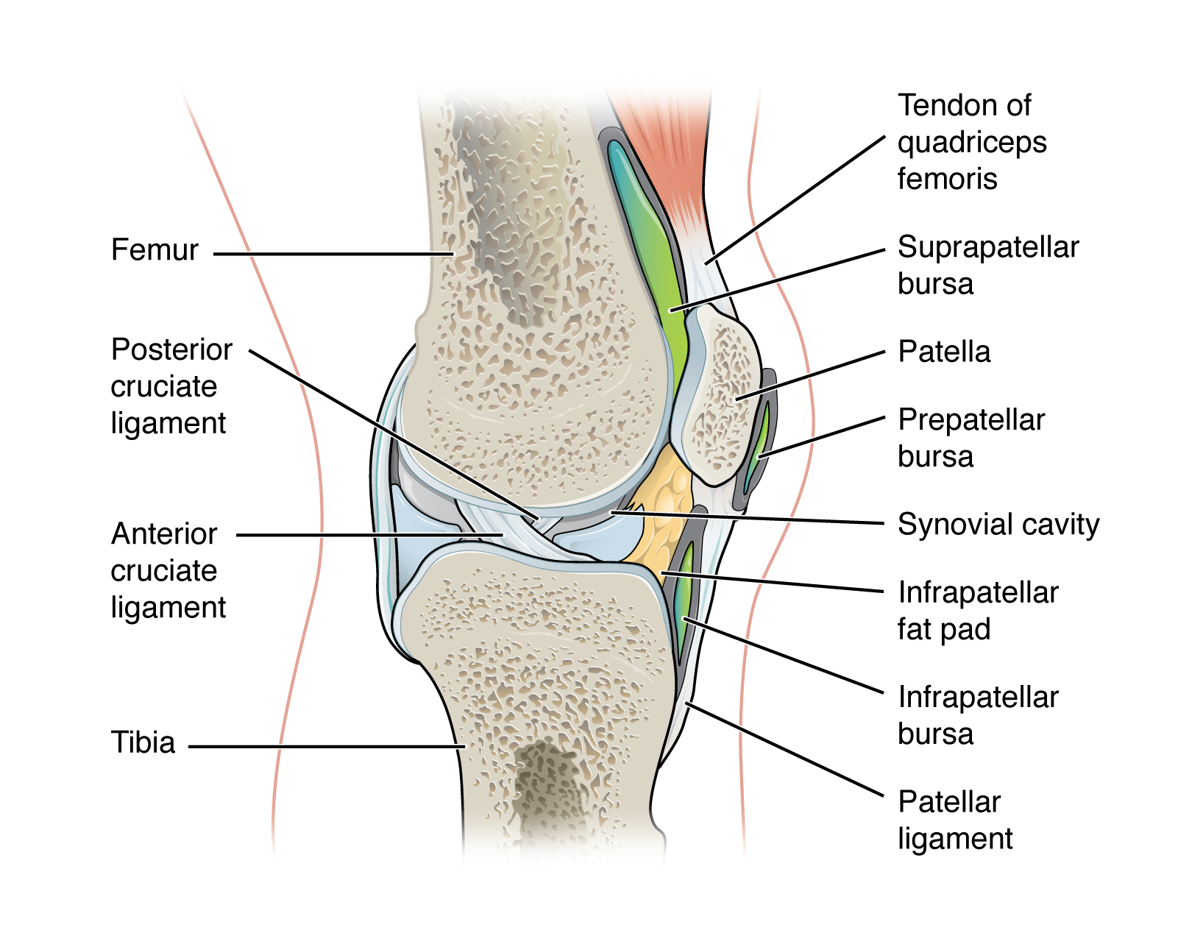

Slide 22
Continued
- Menisci:
Fibrocartilage discs found in certain synovial joints
(e.g., knee), providing stability, cushioning, and improving congruence between joint surfaces.

Slide 23


Slide 24


