Slide 1
Applied Science
Fsc
AWAIS HAMZA

Slide 2
Momentum
Momentum is the measure of an object's motion and is calculated by multiplying its mass by its velocity (p=mv).
It is a vector quantity, meaning it has both magnitude and direction. An object's momentum increases with its mass or velocity. The standard SI unit for momentum is the kilogram-meter per second (kg·m/s).

Slide 3
Momentum
To understand the concept of momentum, let’s consider an example involving two buddies, Sam and Max, who are jogging on a playground. Sam weighs 30 kilograms, and Max weighs 40 kilograms. Both of them are moving at the same pace and in the same direction.
(a) Who has more momentum, and why?
(b) Who will experience more impact if they collide with a wall?

Slide 4
Momentum
The answer to both questions is Max.
Although Sam and Max have the same velocity, their momentum will depend on their mass. Since Max has a greater mass, he will possess more momentum compared to Sam. Max, with a greater mass, will experience more impact when colliding with the wall. This is because momentum is directly proportional to mass, and Max has more momentum due to his higher mass compared to Sam.

Slide 5
Momentum and second law of motion
Newton’s second law states that the acceleration of an object depends upon two variables – the net force acting on the object and the mass of the object.
The acceleration of the body is directly proportional to the net force acting on the body and inversely proportional to the mass of the body.
This means that as the force acting upon an object is increased, the acceleration of the object is increased. Likewise, as the mass of an object is increased, the acceleration of the object is decreased.

Slide 6
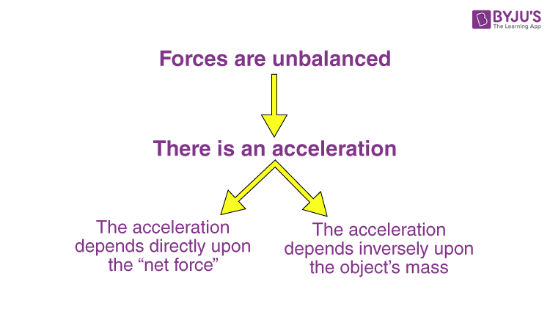
Momentum

Slide 7
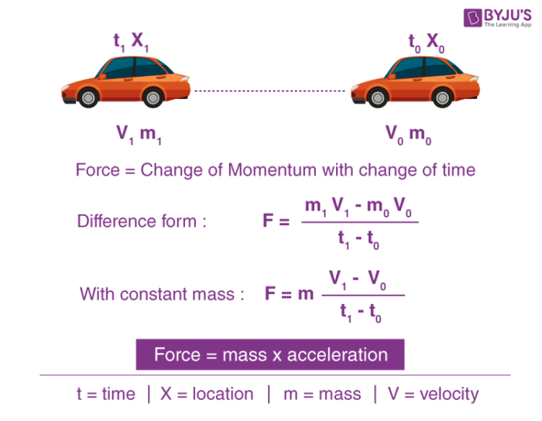
Deriving Newton Second law

Slide 8
Impulse
In physics, impulse is the change in an object's momentum caused by a force acting over a period of time. It is calculated as the product of the force and the time interval during which it acts, and its formula is J=FΔt equals cap F delta t
𝐽=𝐹Δ𝑡
. Impulse is equal to the change in momentum, which can be expressed as the final momentum minus the initial momentum J=Δp=mv−mu equals delta p equals m v minus m u
𝐽=Δ𝑝=𝑚𝑣−𝑚𝑢).

Slide 9
law of conservation of momentum
The law of conservation of momentum states that
the total momentum of an isolated system remains constant, meaning momentum is neither created nor destroyed, only transferred between objects. Momentum is calculated as the product of an object's mass and its velocity (p=m⋅vp equals m center dot v
𝑝=𝑚⋅𝑣
). This principle holds true for collisions within a closed system, where the total momentum before the collision equals the total momentum after the collision.

