Slide 1

SOCIAL COGNITION - II
“Heuristics”
Social Psychology
Hafsa Rasheed

Slide 2

What Is Social Cognition?
The mental processes behind social understanding
• Social cognition = how people perceive, remember, and interpret social information
• Deals with understanding others’ behavior and predicting future actions
• Many errors occur because our minds use shortcuts to save time

Slide 3
Why We Use Shortcuts (Heuristics)?
Human thinking has limits
• Working memory can hold only 5–9 items
• Complex decisions overwhelm the brain
• So the mind uses heuristics—quick rules—to reduce effort
• Introduced by Daniel Kahneman (Israeli-American, Princeton University) & Amos Tversky (Israeli-American, Stanford University)

Slide 4
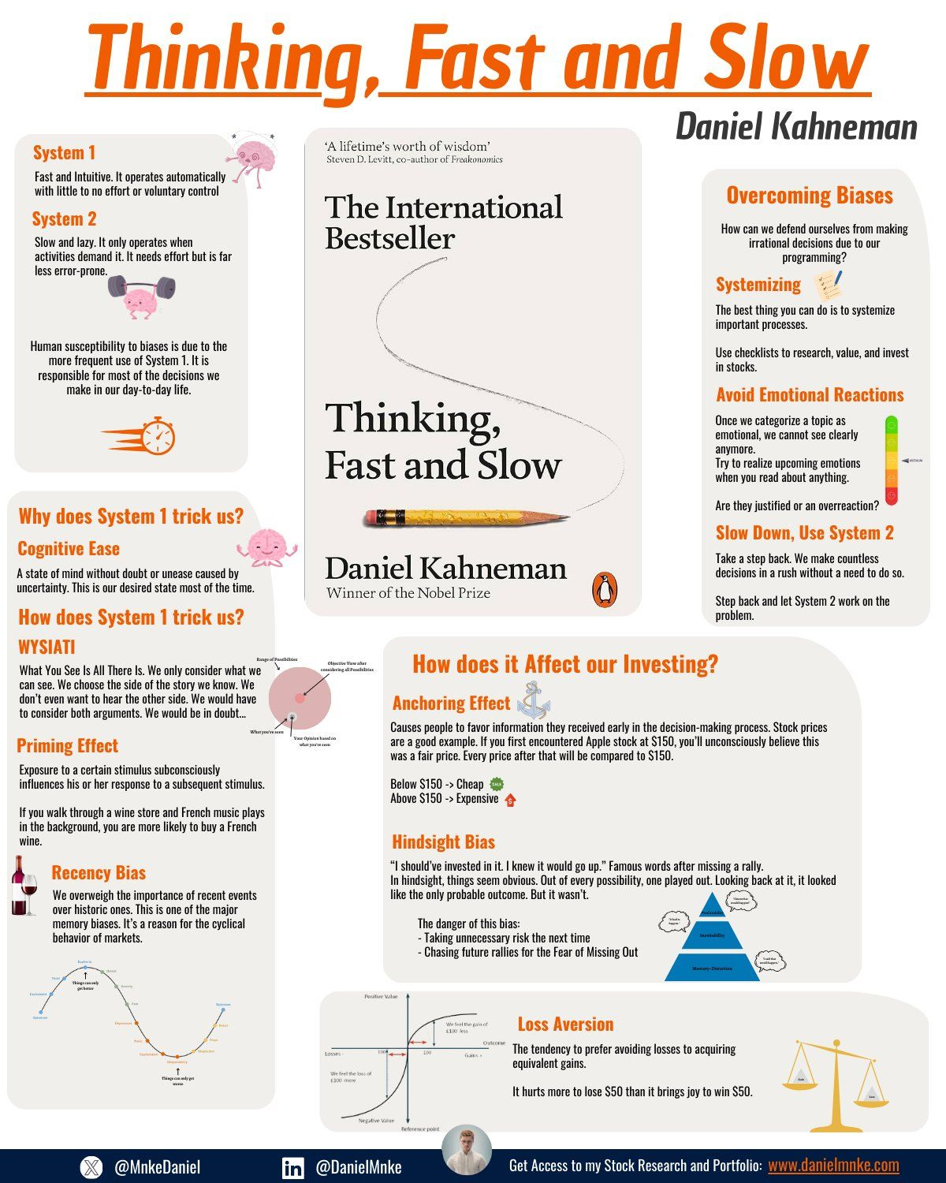
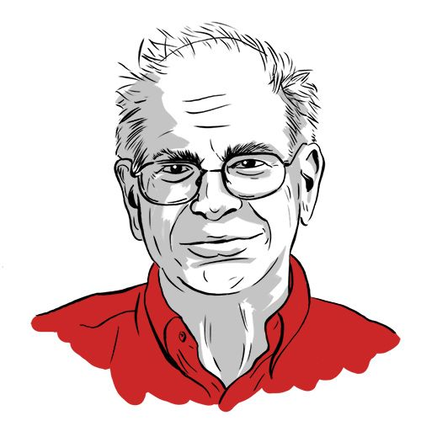

Slide 5
What Are Heuristics?
Mental shortcuts for fast decisions
• Used when decisions must be quick
• Reduce mental load
• Often helpful—but lead to predictable biases
• Core idea from Kahneman & Tversky’s 1974 paper “Judgment Under Uncertainty: Heuristics and Biases”

Slide 6
Three Major Heuristics
Representativeness → judging by similarity
Availability → judging by ease of recall
Anchoring → judging by starting point
These shape everyday thinking without awareness

Slide 7
Representativeness Heuristic
How we judge people by resemblance
• We match a person to a stereotype or prototype
• “If it looks like a duck, it must be a duck” thinking
• Leads to ignoring actual probabilities (base rates)
That’s story over statistics.

Slide 8
The Linda Problem
Most famous representativeness experiment
• Story about “Linda” (philosophy student, activist)
• People choose: “bank teller + feminist”
• Statistically impossible—conjunction fallacy
• Shows how stereotypes overpower logic

Slide 9
Base Rate Fallacy
Ignoring real statistical information
• Base rates = actual numeric probabilities
• People ignore them and focus on stereotypes
• Common in crime judgments, professions, diagnosis

Slide 10
Experiment: Jack the Engineer
How personality descriptions overpower statistics
• Participants told: 30 engineers + 70 lawyers
• Given description of “Jack”
• If description matched engineer stereotype → participants said “engineer”
• Even though probability cannot exceed 30%
• Clear proof of base rate neglect

Slide 11
Availability Heuristic
Judging likelihood based on memory ease
• If examples come to mind quickly → we think they are common
• Influenced by media, emotions, and personal experience
• Strongly shaped by vivid or dramatic events

Slide 12
K-Word Study
Words starting with K vs K as third letter
• More words actually have K as third letter
• But people recall words starting with K more easily
• Shows memory accessibility drives judgments

Slide 13
Study on Assertiveness
Memory difficulty affects self-judgment
• German social psychologist Norbert Schwarz (University of Michigan)
• Participants recalled 6 or 12 assertive behaviors
• Recalling 12 was harder → people rated themselves LESS assertive
• Shows difficulty of recall influences thinking

Slide 14
Everyday Availability Errors
How recall distorts reality
• Fear of plane crashes (media coverage)
• Overestimating shark attacks
• Thinking crime is rising due to news cycles
• Survivor bias: “My uncle smoked and lived 90 years”

Slide 15
Anchoring & Adjustment Heuristic
The power of the first number you hear
• We rely on the initial value (anchor)
• Adjust from it—but never enough
• Happens even when anchors are random

Slide 16
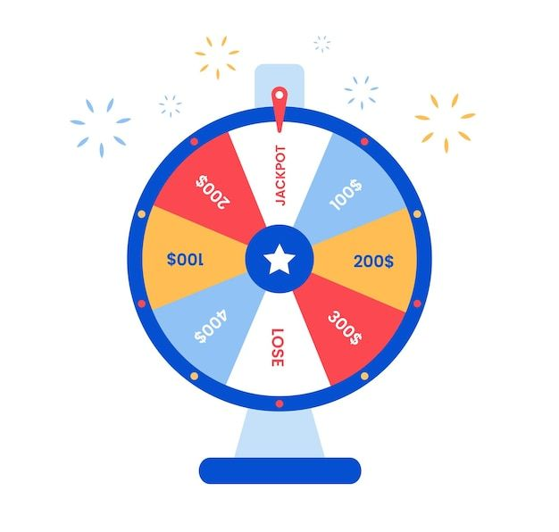
UN African Countries Experiment
Random numbers still influence judgments
• Wheel of fortune: anchors = 10% or 65%
• Group with 10% anchor guessed lower
• Group with 65% anchor guessed higher
• Anchors distort judgment even when meaningless

Slide 17
Plous (1989) Nuclear War Study
Anchors in global risk
• American psychologist Scott Plous (Wesleyan University)
• Asked two versions:
– “More than 1% chance of nuclear war?”
– “Less than 90% chance?”
• Different anchors → huge difference in estimates

Slide 18
Why Heuristics Matter
How shortcuts affect real life
• Influence job interviews, police decisions, elections
• Affect medical diagnosis
• Shape interpersonal impressions
• Understanding them reduced errors

Slide 19


