Slide 1

Social Psychology
BS MLT
Hafsa Rasheed

Slide 2
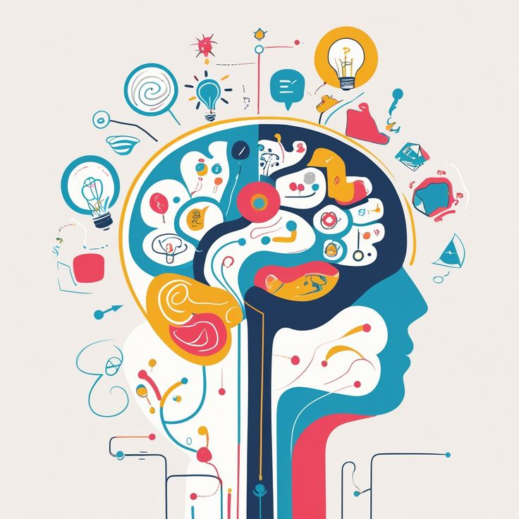
Overview
Cognition, Affect & Behavior
Social Psychology: a Science
Applications of Social Psychology
Attribution

Slide 3
Components of Human Behavior
Component | Meaning | Example (for instructor)
Cognition | Mental processes: thinking, interpreting, remembering social information. | Belief that a peer ignored you.
Affect | Emotions and moods that accompany perceptions or thoughts. | Feeling hurt or sad.
Behavior | Observable actions or reactions in social contexts. | Avoiding or confronting someone.

Slide 4
Interaction Between Cognition, Affect, and Behavior
• Cognition influences Affect: thoughts shape emotions.
• Affect influences Behavior: emotions drive actions.
• Behavior can reshape Cognition and Affect through feedback.
• All three continuously interact to shape social behavior.

Slide 5
Social Psychology as a Science – I
• Social Psychology uses systematic, scientific methods to study behavior.
• Core principles: Objectivity, Empiricism, Control, Prediction.
• Aim: to explain, predict, and sometimes control social behavior.

Slide 6
Social Psychology as a Science – II
• Skepticism: findings are constantly questioned and re-evaluated.
• Parsimony: prefer simplest adequate explanation of behavior.
• Precision: define variables clearly for accurate measurement.
• Public Verification: publish and review research for reliability.

Slide 7
Social Psychology as a Science – III
• Theory Development: ideas explaining social behavior.
• Hypothesis Formation: testable prediction from theory.
• Empirical Testing: controlled observation and experimentation.
• Analysis, Interpretation, and Replication ensure reliability.

Slide 8
Environment & Cultural Context
• Environment:
- Physical variables (temperature, crowding) affect mood and behavior.
• Cultural Context:
- Culture (values, language, norms) shapes preferred actions (e.g., individualistic vs collectivistic decisions).

Slide 9
Biological Factors: Physiological & Neurological
• Physiological and Neurological factors influence social behavior.
• Common measures: EEG (brain waves), fMRI/MRI (brain activity), PET, GSR (skin conductance), HR/HRV (cardiovascular), EMG (muscle activity), pupillometry, eye-tracking.
• These methods link biological substrates to social processes.

Slide 10
Behavior Genetics & Evolutionary Social Psychology
• Behavior Genetics:
- Methods: family studies, twin studies (MZ vs DZ), adoption studies to estimate genetic vs environmental influences.
• Evolutionary Social Psychology:
- Applies natural selection principles: variation, inheritance, selection.
- Concepts: sexual selection, kin selection, parental investment affecting social traits.

Slide 11
Attribution Theory – I
• Process of explaining causes behind behavior.
• Humans act as 'naïve scientists' seeking meaning.
• Proposed by Fritz Heider (1958)—Father of Attribution Theory
• Two main types: Internal (dispositional) and External (situational).

Slide 12
Attribution Theory – II
• Internal: cause lies within person (traits, motives, ability).
• External: cause lies in situation or environment.
• Helps understand how people interpret and judge behavior.

Slide 13
Attribution Dimensions – III
• Locus: Internal vs. External causes.
• Stability: Stable vs. Unstable over time.
• Controllability: whether the cause is under personal control.
• Developed by Weiner (1979) to explain motivation and response.

Slide 14
Continued
“I’m not smart enough” → Internal, Stable, Uncontrollable → leads to hopelessness.
“I didn’t study enough” → Internal, Unstable, Controllable → leads to motivation to try again.
“The test was unfair” → External, Uncontrollable → may cause anger or resentment.

Slide 15
Attribution Biases – IV
• Fundamental Attribution Error: overemphasizing internal causes.
• Self-Serving Bias: success = self; failure = situation.
• Actor–Observer Bias: own actions situational; others' actions dispositional.

Slide 16
Applications of Social Psychology
• Education: enhance learning and classroom relationships.
• Workplace: leadership, motivation, and teamwork improvement.
• Health: promote healthy habits and stress management.
• Society: reduce prejudice, promote cooperation, and positive change.

Slide 17
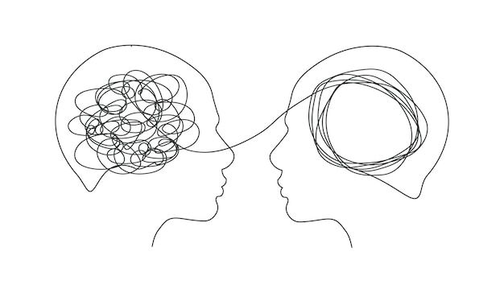
Any Questions? / Activity
• Describe a recent social interaction and identify the cognition, affect, and behavior involved. Class shares 2 examples.

