Slide 1
Statistics
DPT
AWAIS HAMZA

Slide 2
Relative frequency
The relative frequency for a class can be computed by dividing its frequency by the total frequency. It should be noted that the sum of the relative frequencies is one except for rounding error.

Slide 3
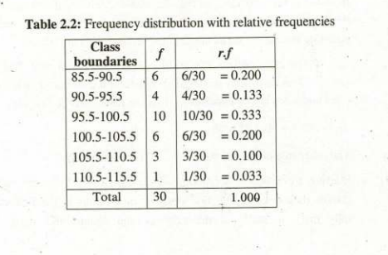

Slide 4
For discrete data
In case of discrete data, each observation is a whole number.
So, while making a frequency distribution, the possible values are written in a column and a tally count of each value is made for the data.
The number of tally count for each value is its frequency.
The corresponding relative frequency is obtained by dividing each frequency by the total number of observations.
The sum of the relative frequencies should be 1 except for rounding error.

Slide 5
For categorical data:
In case of categorical data, the categories a are placed in column and a tally count is made for each category going through the data set which gives the frequency of each category.

Slide 6
Example
The observations about the number of rotten potatoes from twenty equal sized samples taken from a store are available as follows: 1, 2, 4, 3, 0, 1, 2, 3, 1, 1, 0, 2, 1, 0, 2, 3, 0, 0, 1, 3

Slide 7
Solution
The tally count and frequency table is made by going through each observation of the data and for each observation making a mark, vertical bar | against the appropriate value of the variable. In this data, the values of the variable vary from 0 to 4. These are written in a column and a tally count is kept going through the whole data. T

Slide 8
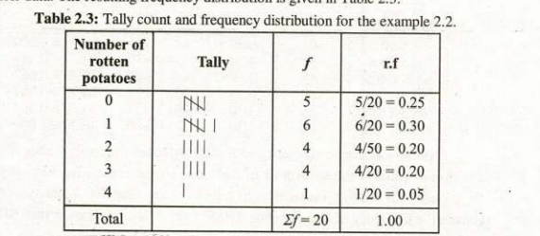

Slide 9
Open-end classes
In connection with the frequency tables, the térm open end classes is sometimes used.
It means that in a frequency table, either the lower limit of the Ist class or the upper limit of the last class is not a fixed number.
It may happen that both of these are not fixed numbers.
The frequency tables with open end classes are formed in some practical situations. The frequency table about the age of people in a certain locality is given in the adjacent table:

Slide 10
Cumulative Frequency Distribution
A cumulative frequency distribution is a table that displays class intervals and the corresponding cumulative frequencies. The cumulative frequency is denoted by c.f and for a class interval it is obtained by adding the frequencies of all the preceding classes including that class. It indicates the total number of values less than or equal to the upper limit of that class.

Slide 11
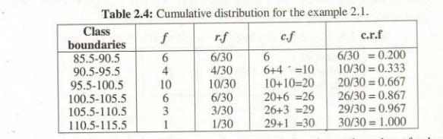

Slide 12
Cumulative Frequency Distribution
As the cumulative frequency of a class indicates the total number of values less than or equal to the upper limit of that class, so, the cumulative frequency of 20 for a class 95.5 - 100.5 means that 20 values are less than 100.5 and similarly, the cumulative frequency of the last class 110.5 - 115.5 is 30 indicating that 30 values are less than 115.5.

Slide 13
Cumulative Frequency Distribution
The cumulative relative frequencies which are the proportions of the cumulative frequency, denoted by c.rf are obtained by dividing the cumulative frequency by the total frequency. The c.r.f of a class can also be obtained by adding the relative frequencies of the preceding classes including that class. As cumulative relative frequencies are proportions, the multiplication by 100 gives corresponding percentage cumulative frequencies.

Slide 14
Cumulative frequency distribution for discrete data
The cumulative frequency distribution for the discrete dáta is obtained in the same way as for the continuous data i.e., the cumulative frequency of a class is obtained simply by adding the preceding frequencies including the frequency for that class.

Slide 15
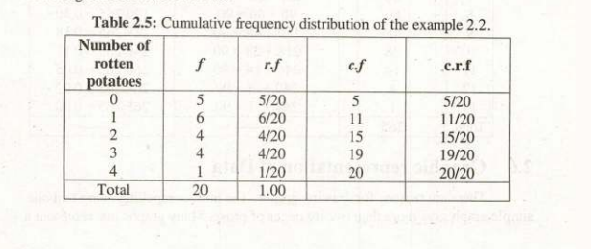

Slide 16
Find out the relative frequency distribution for the following data. Where x denotes the number of hours worked in a day by a person in a locality of 265 people.

Slide 17


Slide 18
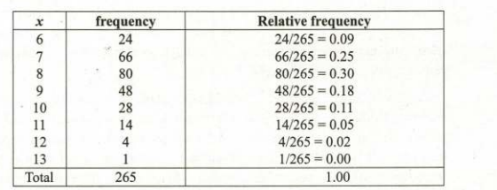
Solution

Slide 19

Cumulative frequency distribution
Find out the relative cumulative frequency distribution from the following data of example 2.4.

Slide 20
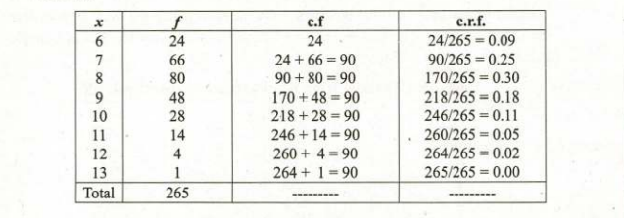
Solution

