Slide 1
ANATOMY
BS OTT,RIT,MLT
1ST SEMESTER
DR DANISH

Slide 2
SHORT BONES
Definition:
Small, cube-shaped bones
Equal in length, width, and thickness
Found where limited movement is needed

Slide 3
Function
Provide support and stability
Allow slight movement
Help absorb shock and pressure

Slide 4
Examples
Carpals (wrist bones)
Tarsals (ankle bones)

Slide 5
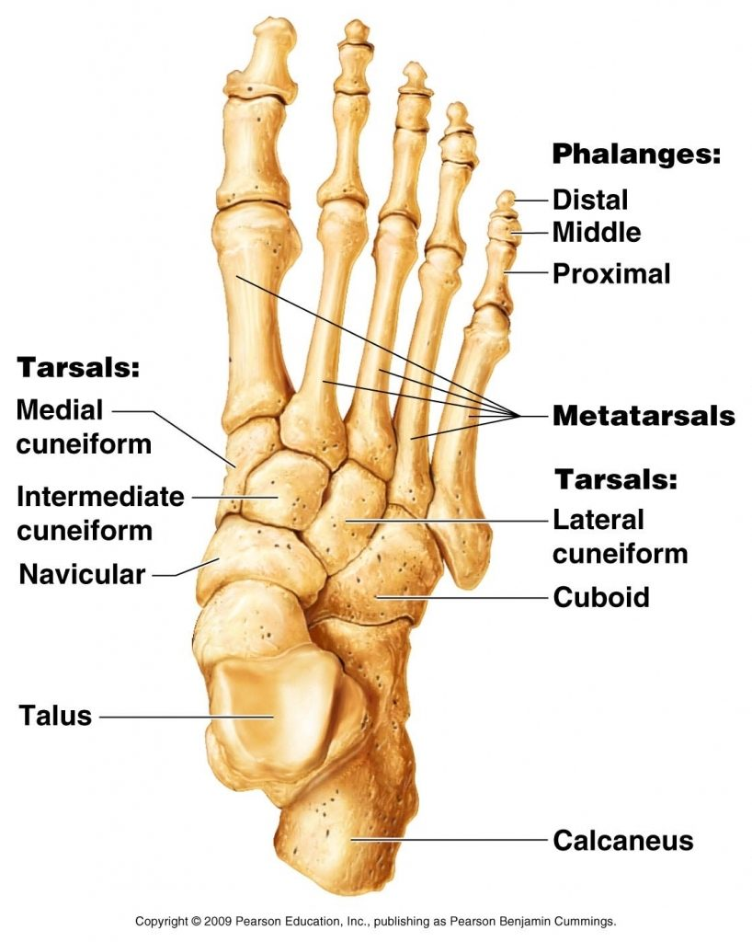

Slide 6
Flat Bones
Definition:
Thin, flattened, and often curved
Two layers of compact bone with spongy bone in between

Slide 7
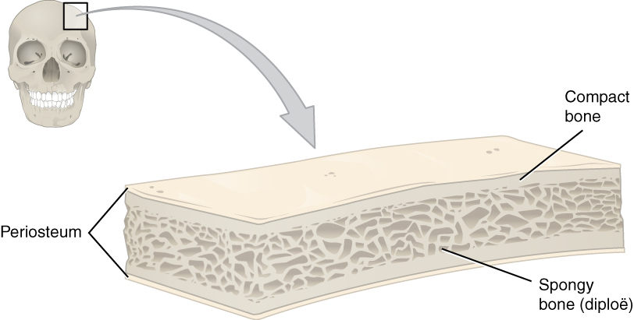

Slide 8
Function
Protection of vital organs
Attachment for muscles
Produce blood cells in red marrow

Slide 9
Examples
Skull (cranial bones)
Sternum (breastbone)
Ribs and Scapulae (shoulder blades)

Slide 10
Irregular bones
Definition
Complex shapes that don’t fit other categories
Often have projections, ridges, or holes

Slide 11
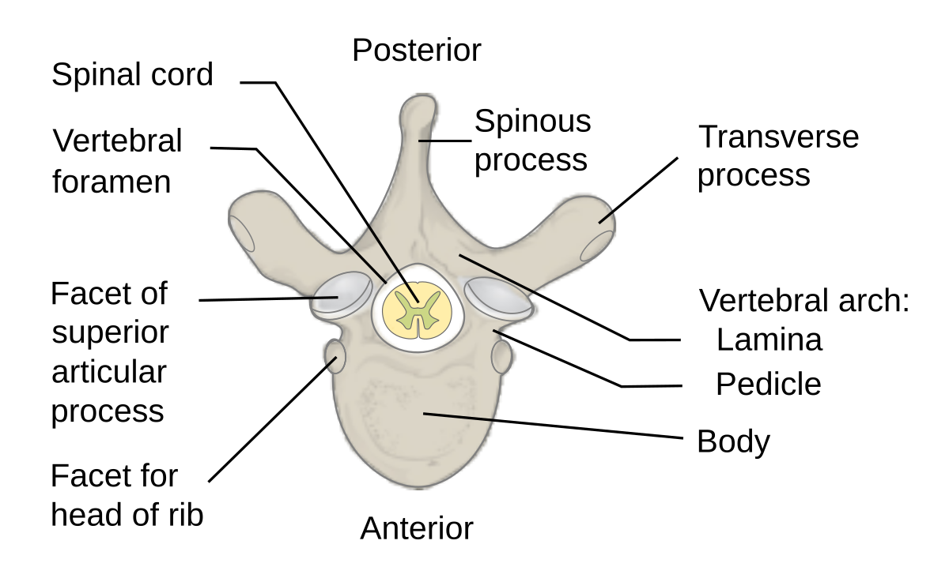

Slide 12
Function
Protect delicate internal structures
Provide sites for muscle attachment
Support the body’s framework

Slide 13
Examples
Vertebrae (spine)
Mandible (jaw bone)
Sphenoid & Ethmoid (skull)

Slide 14
Sesamoid Bones
Definition
Small, round bones embedded within tendons
Develop in areas of friction, tension, or stress

Slide 15
Function & Examples
Protect tendons from stress and wear
Improve mechanical efficiency of muscles
Example: Patella (kneecap), small sesamoids in hands and feet

Slide 16
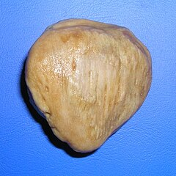

Slide 17
Summary Table
Type | Shape | Function | Example
Short | Cube-like | Stability, support | Carpals
Irregular | Complex | Protection, attachment | Vertebrae
Flat | Thin, flat | Protection, blood cell formation | Skull
Sesamoid | Round, in tendons | Protect tendons | Patella

Slide 18


Slide 19


